Slide 1
CANCER SURVIVAL

Slide 2
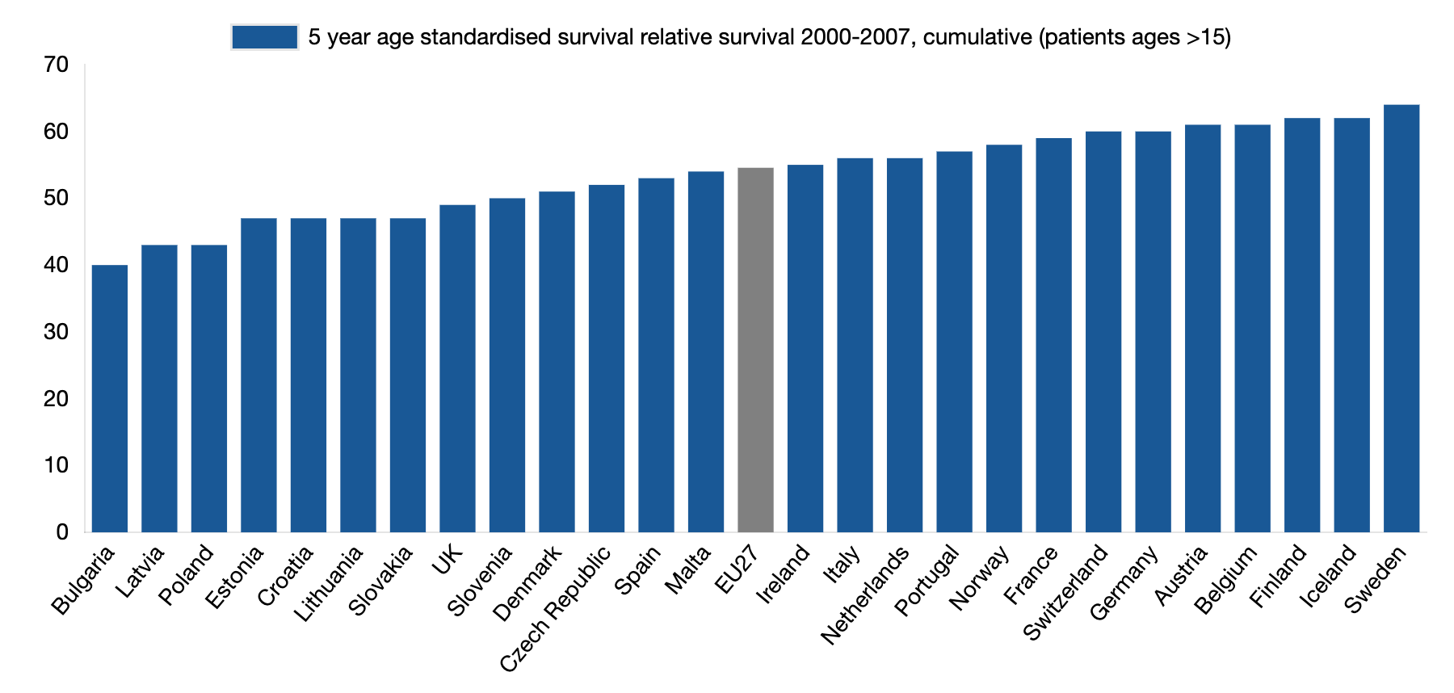
CANCER SURVIVAL 5 YEAR, AGE-STANDARDISED, 2000-2007
In line with incidence, cancer mortality has also increased over the past two decades although at a slower pace. For some countries cancer mortality rates are even declining.
Hofmarcher, T et al. (2019) Comparator Report on Cancer in Europe 2019 - Disease Burden, Costs and Access to Medicines. IHE Report 2019:7. IHE: Lund, Sweden. For further information, please follow: https://efpia.eu/cancer-comparator-report/

Slide 3
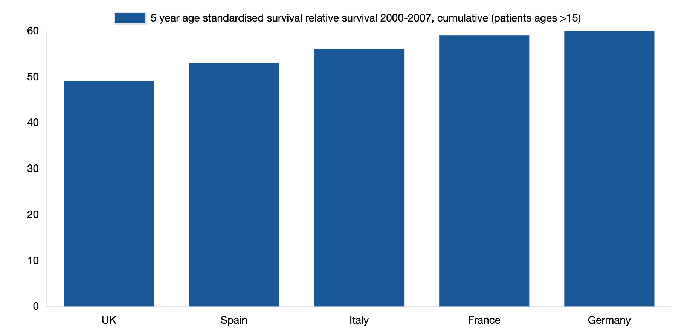
CANCER SURVIVAL 5 YEAR, AGE-STANDARDISED, 2000-2007
In line with incidence, cancer mortality has also increased over the past two decades although at a slower pace. For some countries cancer mortality rates are even declining.
Hofmarcher, T et al. (2019) Comparator Report on Cancer in Europe 2019 - Disease Burden, Costs and Access to Medicines. IHE Report 2019:7. IHE: Lund, Sweden. For further information, please follow: https://efpia.eu/cancer-comparator-report/

Slide 4
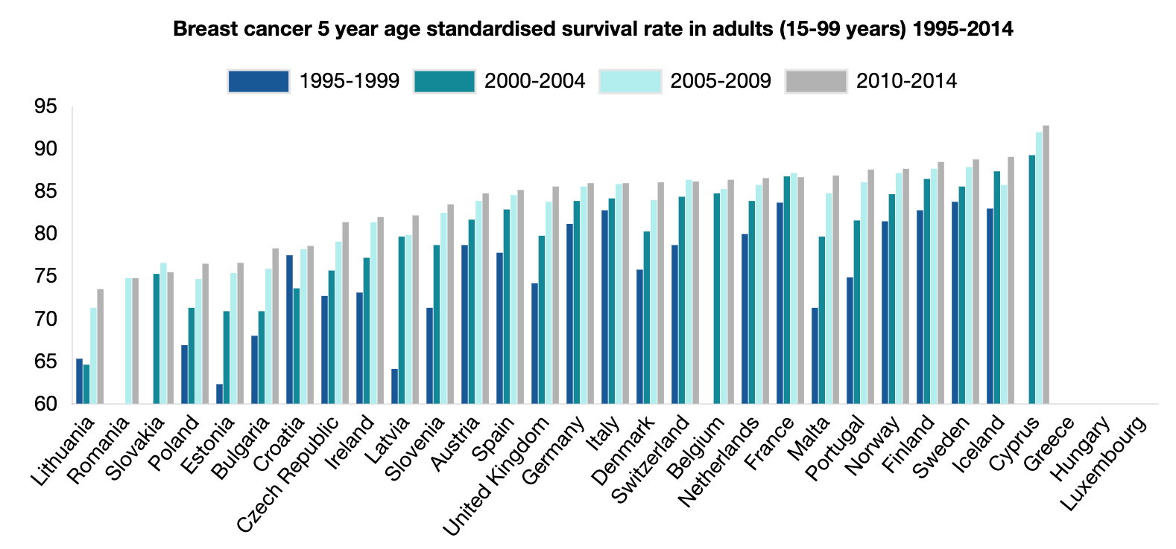
BREAST CANCER SURVIVAL 5 YEAR AGE STANDARDISED, 1995-2014
In 2010–2014, breast cancer 5-year survival ranged from 74% in Lithuania to 89% in Finland, Iceland, and Sweden. Survival rates between different countries are more uniform than in colon cancer, as 16 countries are in the relatively small range of 85% to 89%.
There is a clear pattern of higher survival rates in countries with a higher GDP (except Ireland) and lower survival rates in countries with a lower GDP. However, several countries with a lower GDP (Estonia, Latvia, Malta, Portugal, Slovenia) achieved significant improvements between 1995–1999 and 2010–2014.
Hofmarcher, T et al. (2019) Comparator Report on Cancer in Europe 2019 - Disease Burden, Costs and Access to Medicines. IHE Report 2019:7. IHE: Lund, Sweden. For further information, please follow: https://efpia.eu/cancer-comparator-report/

Slide 5
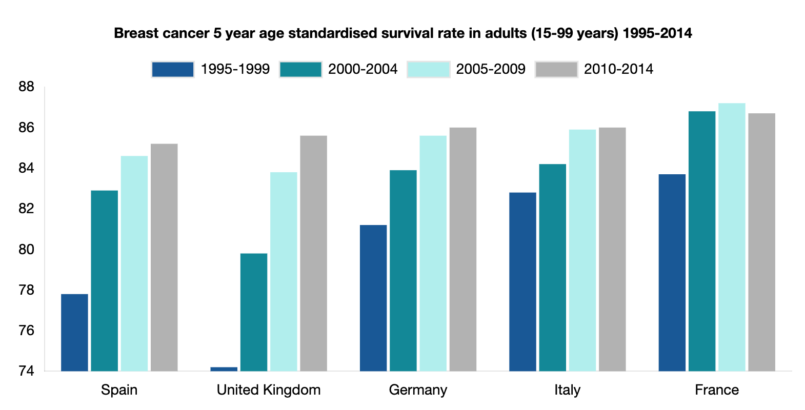
BREAST CANCER SURVIVAL 5 YEAR AGE STANDARDISED, 1995-2014
In 2010–2014, breast cancer 5-year survival ranged from 74% in Lithuania to 89% in Finland, Iceland, and Sweden. Survival rates between different countries are more uniform than in colon cancer, as 16 countries are in the relatively small range of 85% to 89%.
There is a clear pattern of higher survival rates in countries with a higher GDP (except Ireland) and lower survival rates in countries with a lower GDP. However, several countries with a lower GDP (Estonia, Latvia, Malta, Portugal, Slovenia) achieved significant improvements between 1995–1999 and 2010–2014.
Hofmarcher, T et al. (2019) Comparator Report on Cancer in Europe 2019 - Disease Burden, Costs and Access to Medicines. IHE Report 2019:7. IHE: Lund, Sweden. For further information, please follow: https://efpia.eu/cancer-comparator-report/

Slide 6
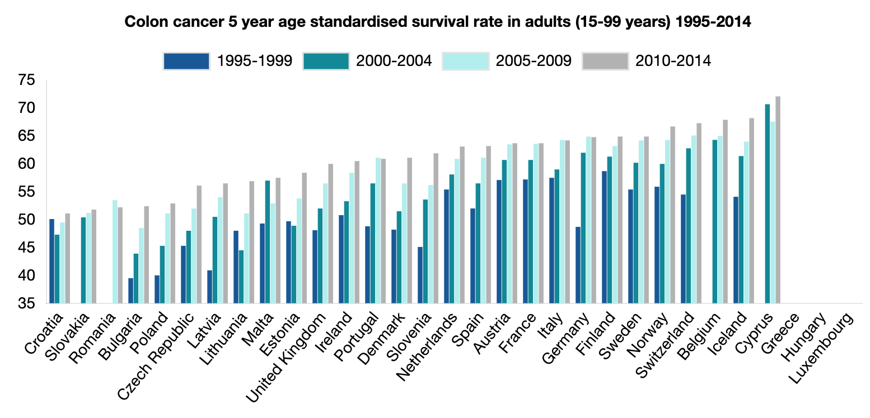
COLON CANCER SURVIVAL 5 YEAR AGE STANDARDISED, 1995-2014
In 2010-2014, colorectal cancer 5-year survival rates ranged from 51% in Croatia to 68% in Belgium and Iceland. There is quite a clear pattern of higher survival rates in countries with higher GDP and lower rates in countries with lower GDP. Noteworthy exceptions to this pattern include the UK, Ireland and Denmark, which recorded lower rates than Slovenia.
Between 1995 and 2014, all countries recorded improvements. The biggest improvements were in Slovenia and Latvia (from a relatively low level) and in Germany (from a relatively high level).
Hofmarcher, T et al. (2019) Comparator Report on Cancer in Europe 2019 - Disease Burden, Costs and Access to Medicines. IHE Report 2019:7. IHE: Lund, Sweden. For further information, please follow: https://efpia.eu/cancer-comparator-report/

Slide 7
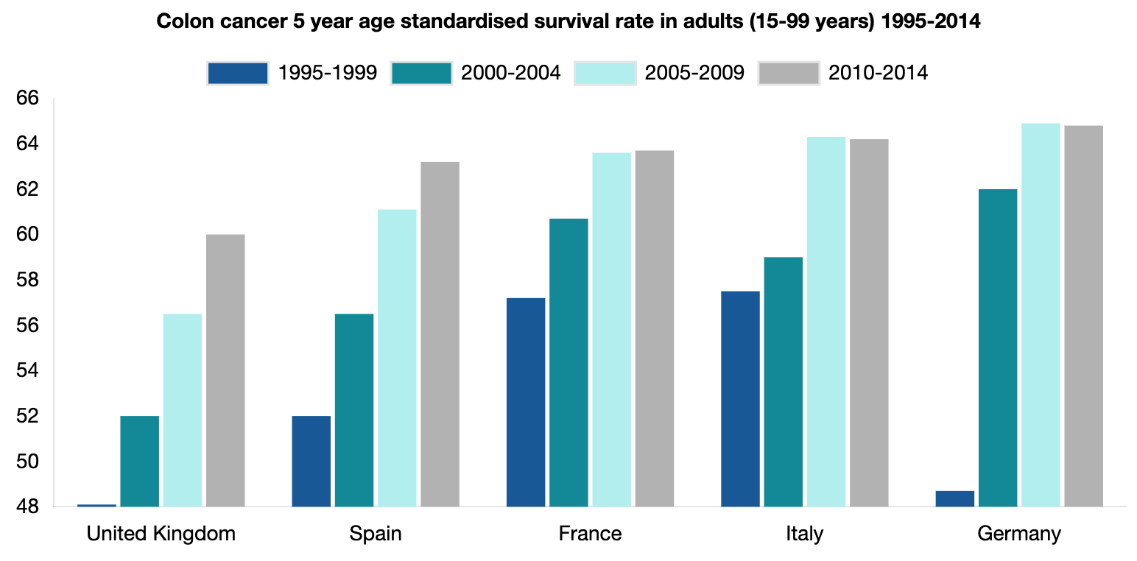
COLON CANCER SURVIVAL 5 YEAR AGE STANDARDISED, 1995-2014
In 2010-2014, colorectal cancer 5-year survival rates ranged from 51% in Croatia to 68% in Belgium and Iceland. There is quite a clear pattern of higher survival rates in countries with higher GDP and lower rates in countries with lower GDP. Noteworthy exceptions to this pattern include the UK, Ireland and Denmark, which recorded lower rates than Slovenia.
Between 1995 and 2014, all countries recorded improvements. The biggest improvements were in Slovenia and Latvia (from a relatively low level) and in Germany (from a relatively high level).
Hofmarcher, T et al. (2019) Comparator Report on Cancer in Europe 2019 - Disease Burden, Costs and Access to Medicines. IHE Report 2019:7. IHE: Lund, Sweden. For further information, please follow: https://efpia.eu/cancer-comparator-report/

Slide 8
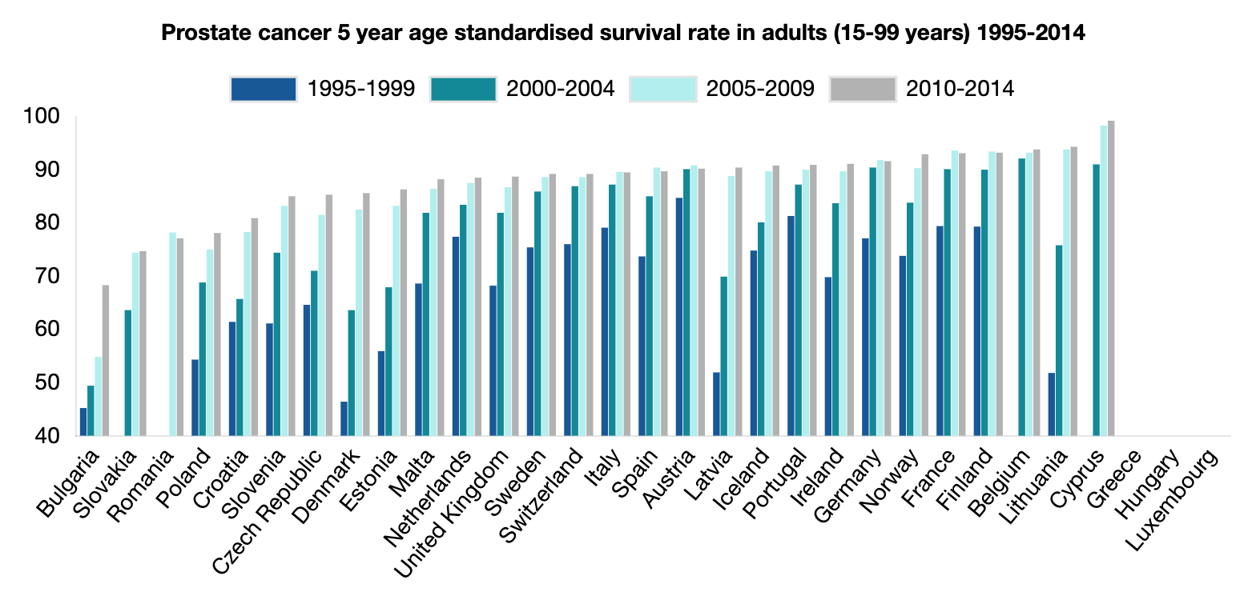
PROSTATE CANCER SURVIVAL 5 YEAR AGE STANDARDISED, 1995-2014
In 2010-2014, prostate cancer 5-year survival rates ranged from 68.3% in Bulgaria and 94.3% in Lithuania.
Hofmarcher, T et al. (2019) Comparator Report on Cancer in Europe 2019 - Disease Burden, Costs and Access to Medicines. IHE Report 2019:7. IHE: Lund, Sweden. For further information, please follow: https://efpia.eu/cancer-comparator-report/

Slide 9
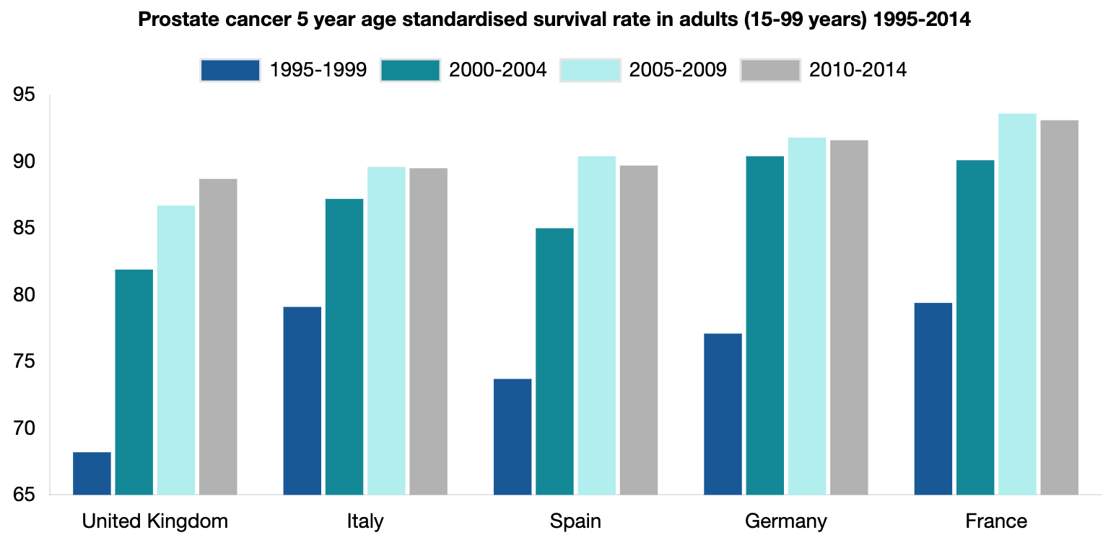
PROSTATE CANCER SURVIVAL 5 YEAR AGE STANDARDISED, 1995-2014
In 2010-2014, prostate cancer 5-year survival rates ranged from 68.3% in Bulgaria and 94.3% in Lithuania.
Hofmarcher, T et al. (2019) Comparator Report on Cancer in Europe 2019 - Disease Burden, Costs and Access to Medicines. IHE Report 2019:7. IHE: Lund, Sweden. For further information, please follow: https://efpia.eu/cancer-comparator-report/

Slide 10
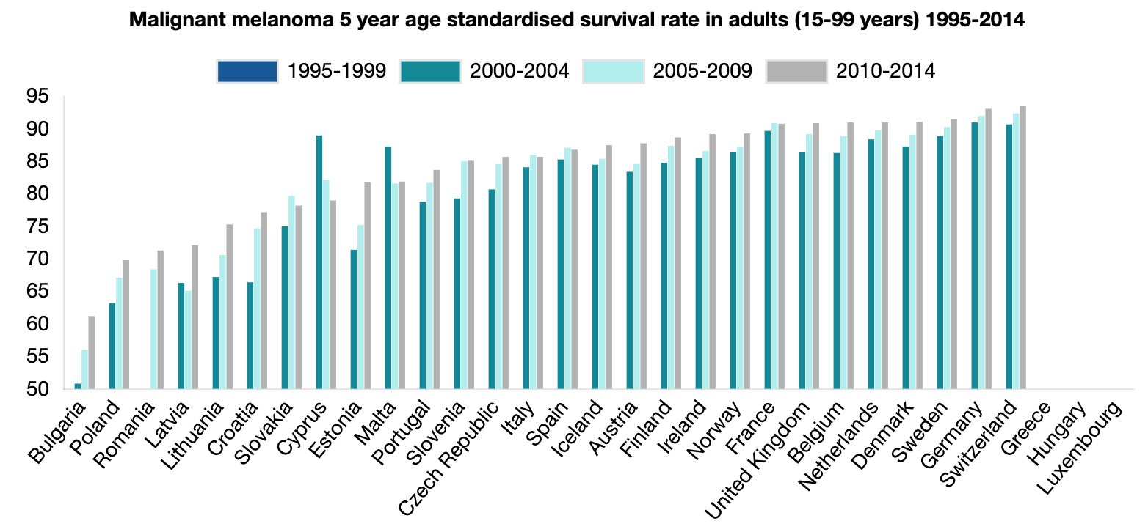
MELANOMA SURVIVAL 5 YEAR AGE STANDARDISED, 1995-2014
In 2010-2014, melanoma 5-year survival ranged from 61.2% in Romania to 93.6% in Switzerland.
Hofmarcher, T et al. (2019) Comparator Report on Cancer in Europe 2019 - Disease Burden, Costs and Access to Medicines. IHE Report 2019:7. IHE: Lund, Sweden. For further information, please follow: https://efpia.eu/cancer-comparator-report/

Slide 11
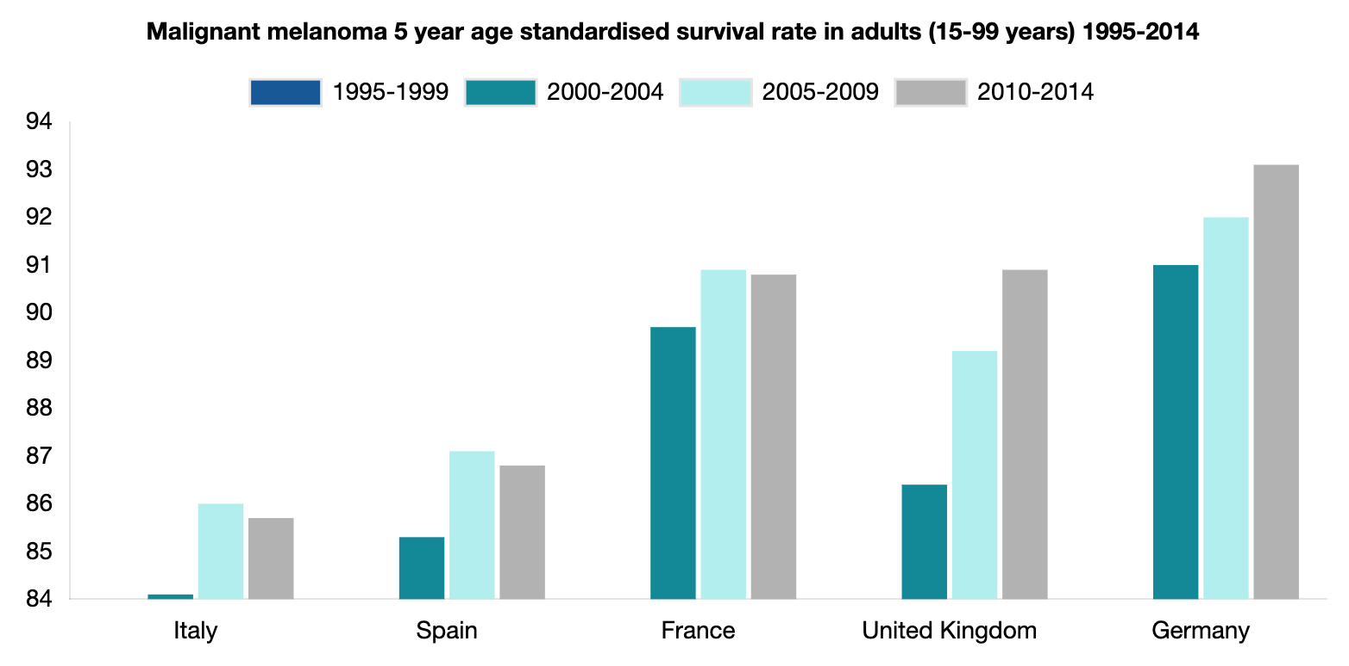
MELANOMA SURVIVAL 5 YEAR AGE STANDARDISED, 1995-2014
In 2010-2014, melanoma 5-year survival ranged from 61.2% in Romania to 93.6% in Switzerland.
Hofmarcher, T et al. (2019) Comparator Report on Cancer in Europe 2019 - Disease Burden, Costs and Access to Medicines. IHE Report 2019:7. IHE: Lund, Sweden. For further information, please follow: https://efpia.eu/cancer-comparator-report/

Slide 12
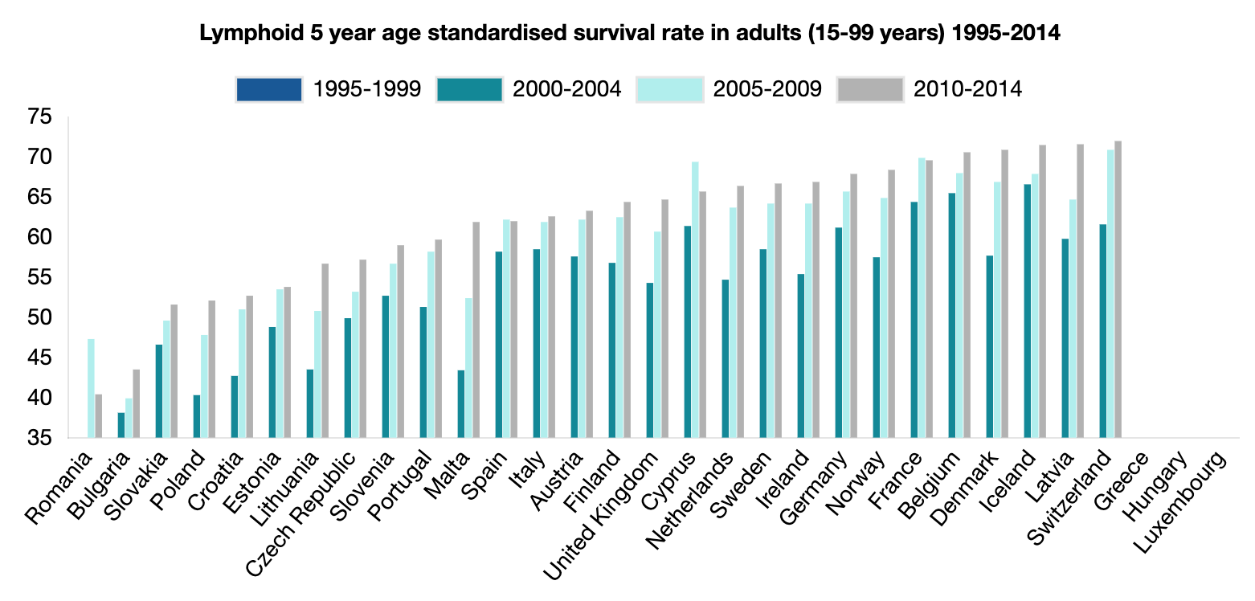
LYMPHOID SURVIVAL 5 YEAR AGE STANDARDISED, 1995-2014
The 5-year age-standardized survival for lymphoid cancers between 2010 and 2014 ranged from 40.4% in Romania and 72% in Switzerland.
Hofmarcher, T et al. (2019) Comparator Report on Cancer in Europe 2019 - Disease Burden, Costs and Access to Medicines. IHE Report 2019:7. IHE: Lund, Sweden. For further information, please follow: https://efpia.eu/cancer-comparator-report/

Slide 13
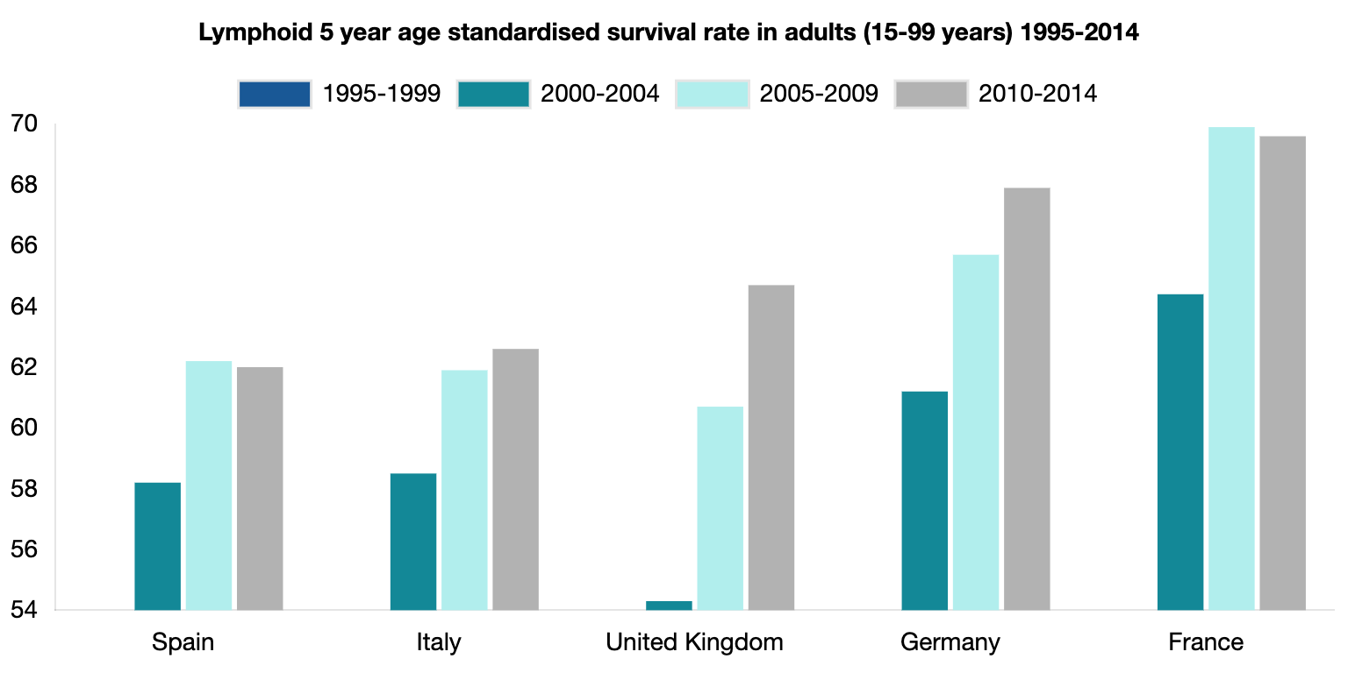
LYMPHOID SURVIVAL 5 YEAR AGE STANDARDISED, 1995-2014
The 5-year age-standardized survival for lymphoid cancers between 2010 and 2014 ranged from 40.4% in Romania and 72% in Switzerland.
Hofmarcher, T et al. (2019) Comparator Report on Cancer in Europe 2019 - Disease Burden, Costs and Access to Medicines. IHE Report 2019:7. IHE: Lund, Sweden. For further information, please follow: https://efpia.eu/cancer-comparator-report/

Slide 14
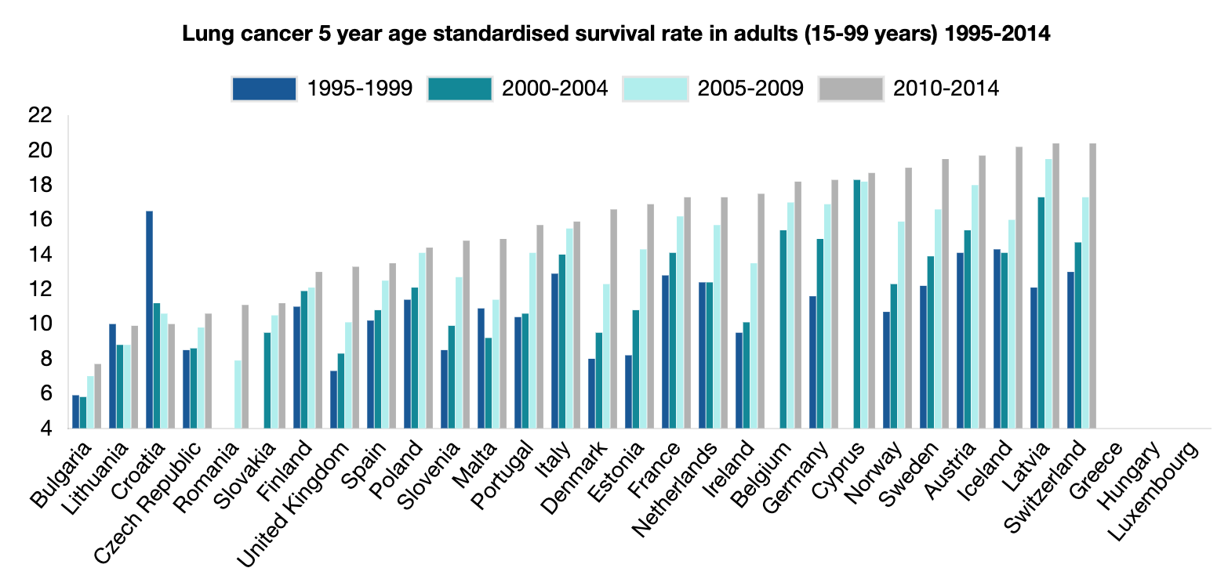
LUNG CANCER SURVIVAL 5 YEAR AGE STANDARDISED, 1995-2014
The 5-year age-standardized survival for lung cancer between 2010 and 2014 ranged from 7.7% in Bulgaria and 20.4% in Switzerland.
Hofmarcher, T et al. (2019) Comparator Report on Cancer in Europe 2019 - Disease Burden, Costs and Access to Medicines. IHE Report 2019:7. IHE: Lund, Sweden. For further information, please follow: https://efpia.eu/cancer-comparator-report/

Slide 15
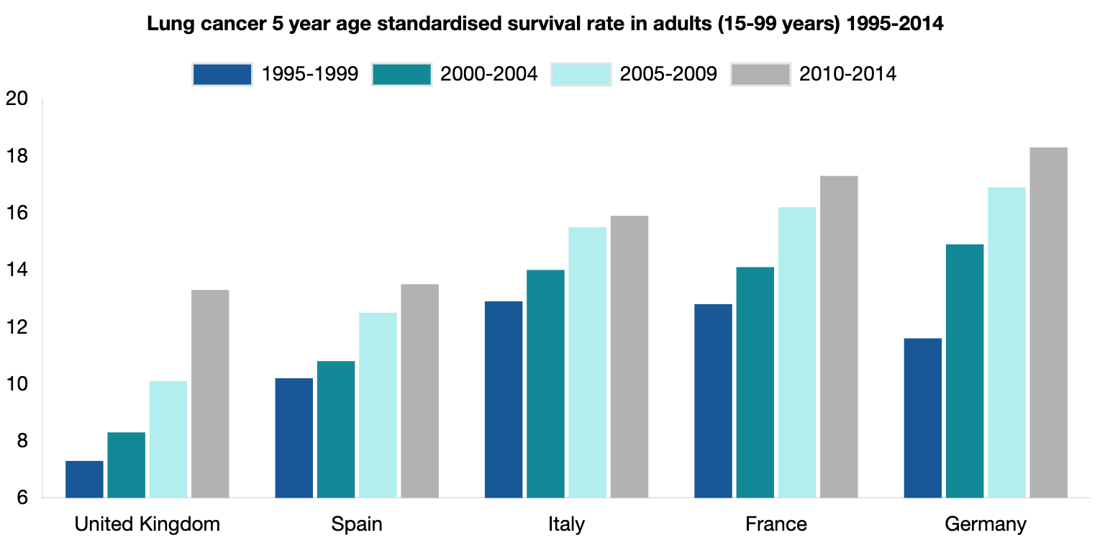
LUNG CANCER SURVIVAL 5 YEAR AGE STANDARDISED, 1995-2014
The 5-year age-standardized survival for lung cancer between 2010 and 2014 ranged from 7.7% in Bulgaria and 20.4% in Switzerland.
Hofmarcher, T et al. (2019) Comparator Report on Cancer in Europe 2019 - Disease Burden, Costs and Access to Medicines. IHE Report 2019:7. IHE: Lund, Sweden. For further information, please follow: https://efpia.eu/cancer-comparator-report/

Slide 16
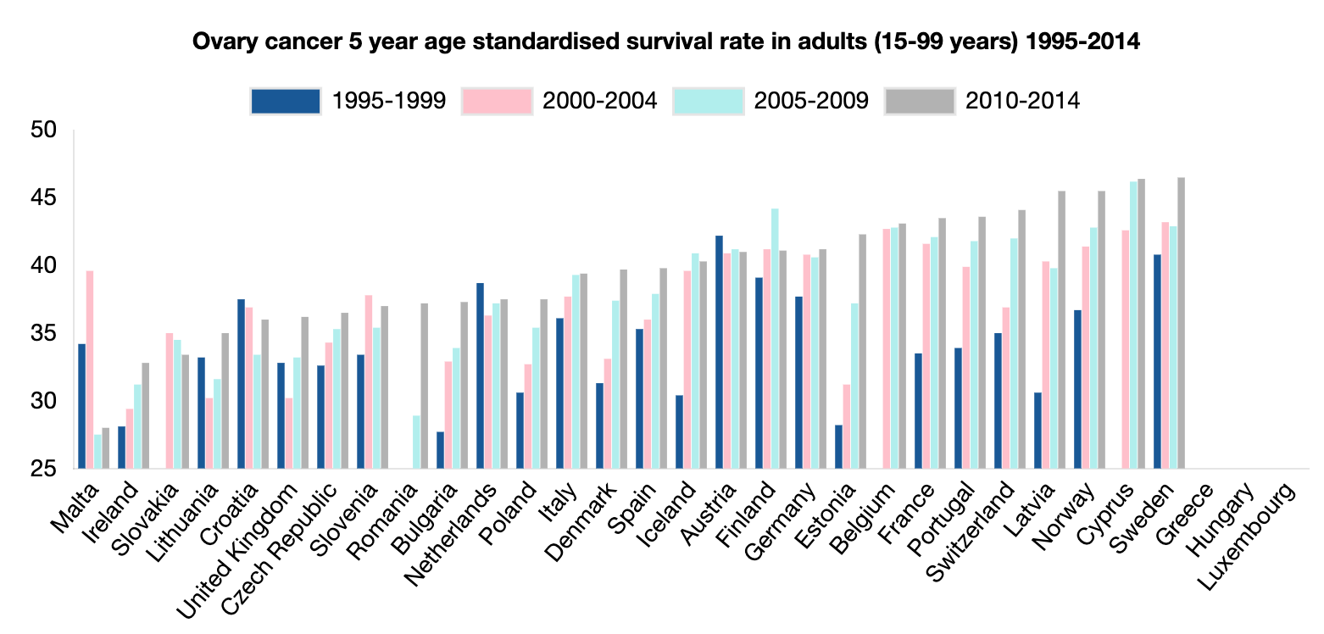
OVARIAN CANCER SURVIVAL 5 YEAR AGE STANDARDISED, 1995-2014
The 5-year age-standardized survival for ovarian cancer between 2010 and 2014 ranged from 28% in Malta and 46.5% in Sweden.
Hofmarcher, T et al. (2019) Comparator Report on Cancer in Europe 2019 - Disease Burden, Costs and Access to Medicines. IHE Report 2019:7. IHE: Lund, Sweden. For further information, please follow: https://efpia.eu/cancer-comparator-report/

Slide 17
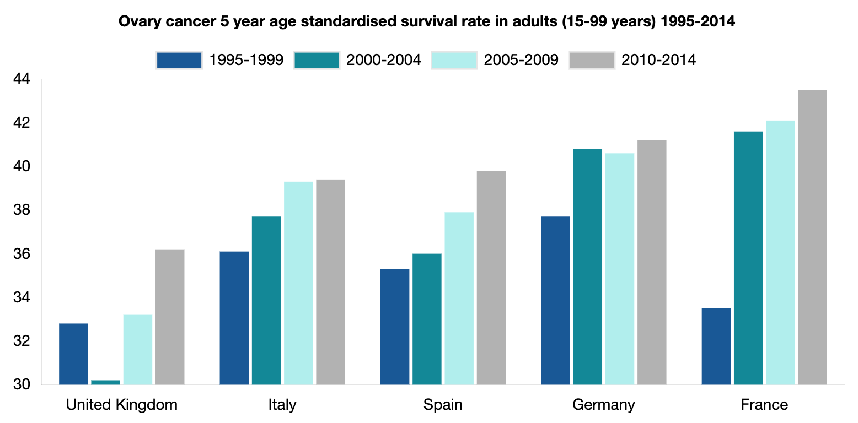
OVARIAN CANCER SURVIVAL 5 YEAR AGE STANDARDISED, 1995-2014
The 5-year age-standardized survival for ovarian cancer between 2010 and 2014 ranged from 28% in Malta and 46.5% in Sweden.
Hofmarcher, T et al. (2019) Comparator Report on Cancer in Europe 2019 - Disease Burden, Costs and Access to Medicines. IHE Report 2019:7. IHE: Lund, Sweden. For further information, please follow: https://efpia.eu/cancer-comparator-report/

