Slide 1
CANCER TYPES
SPENDING

Slide 2
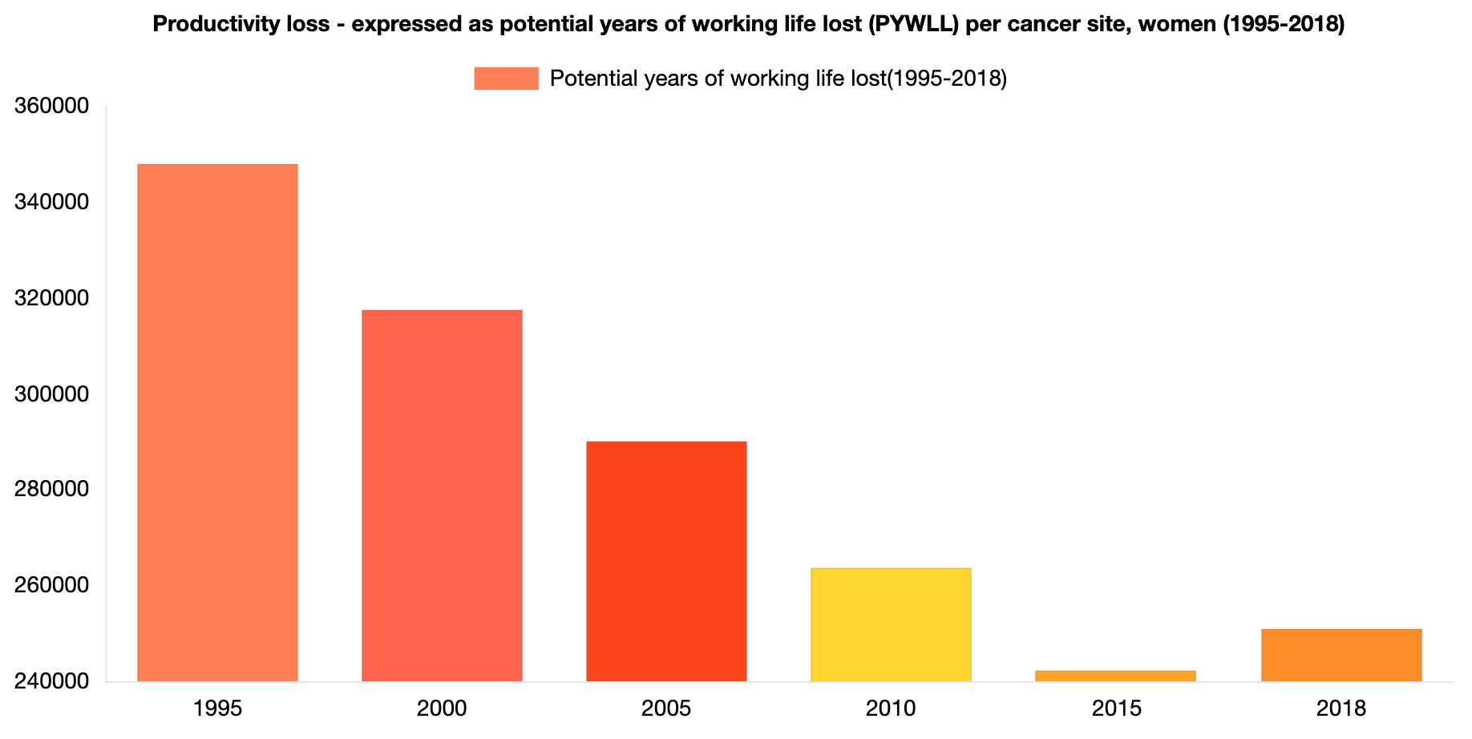
BREAST CANCER SPENDING
Hofmarcher, T et al. (2019) Comparator Report on Cancer in Europe 2019 - Disease Burden, Costs and Access to Medicines. IHE Report 2019:7. IHE: Lund, Sweden. For further information, please follow: https://efpia.eu/cancer-comparator-report/

Slide 3
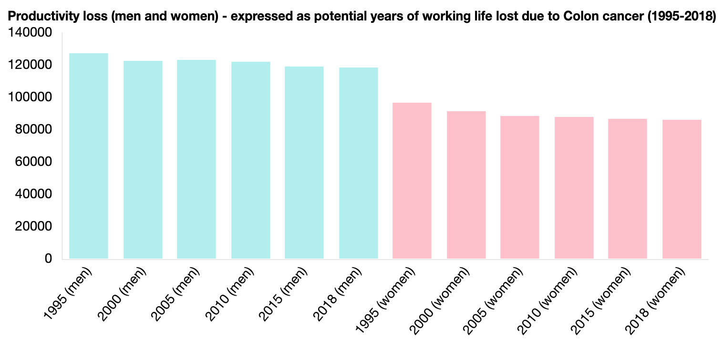
COLORECTAL CANCER SPENDING
Hofmarcher, T et al. (2019) Comparator Report on Cancer in Europe 2019 - Disease Burden, Costs and Access to Medicines. IHE Report 2019:7. IHE: Lund, Sweden. For further information, please follow: https://efpia.eu/cancer-comparator-report/

Slide 4
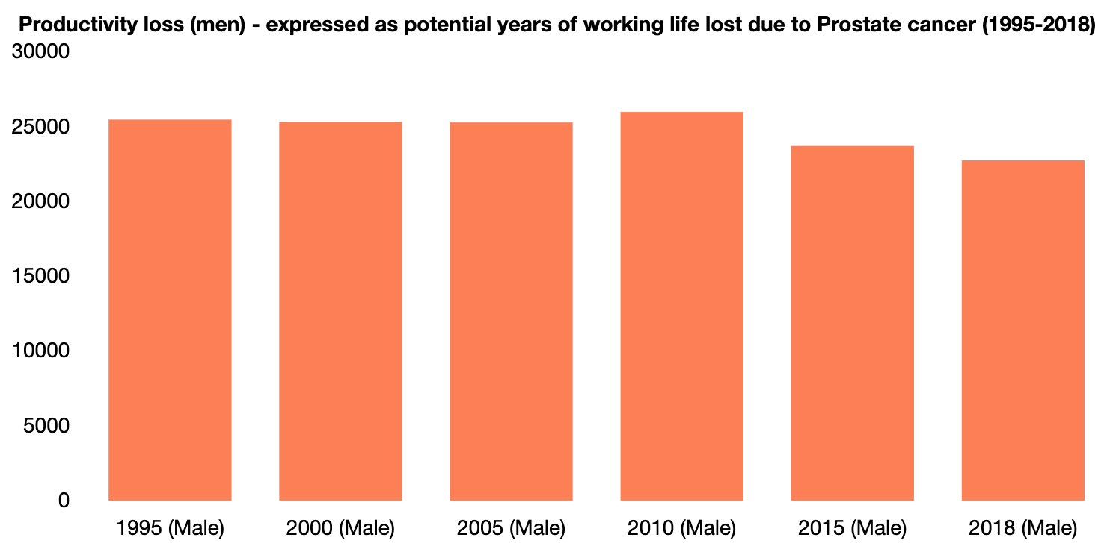
PROSTATE CANCER SPENDING
Hofmarcher, T et al. (2019) Comparator Report on Cancer in Europe 2019 - Disease Burden, Costs and Access to Medicines. IHE Report 2019:7. IHE: Lund, Sweden. For further information, please follow: https://efpia.eu/cancer-comparator-report/

Slide 5
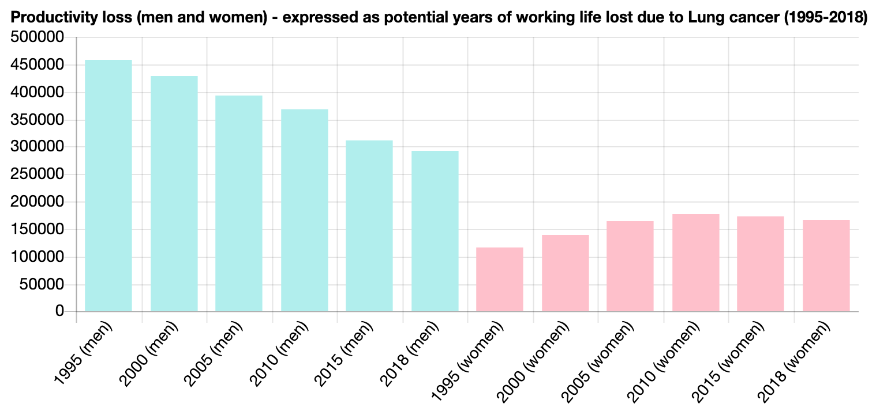
LUNG CANCER SPENDING
Hofmarcher, T et al. (2019) Comparator Report on Cancer in Europe 2019 - Disease Burden, Costs and Access to Medicines. IHE Report 2019:7. IHE: Lund, Sweden. For further information, please follow: https://efpia.eu/cancer-comparator-report/

Slide 6
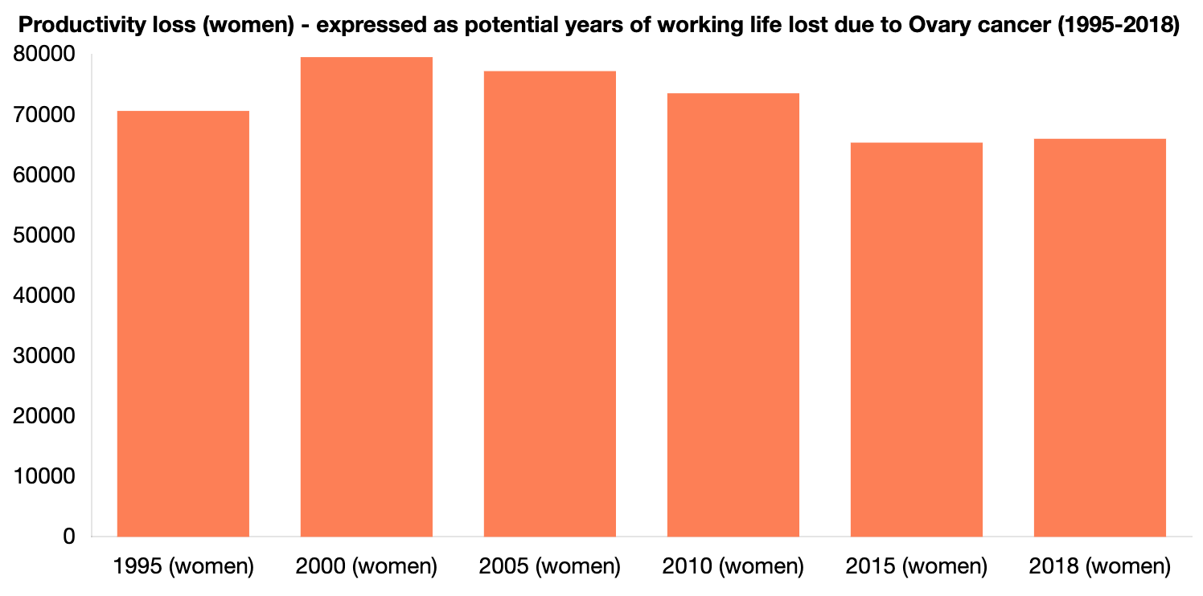
OVARY CANCER SPENDING
Hofmarcher, T et al. (2019) Comparator Report on Cancer in Europe 2019 - Disease Burden, Costs and Access to Medicines. IHE Report 2019:7. IHE: Lund, Sweden. For further information, please follow: https://efpia.eu/cancer-comparator-report/

Slide 7
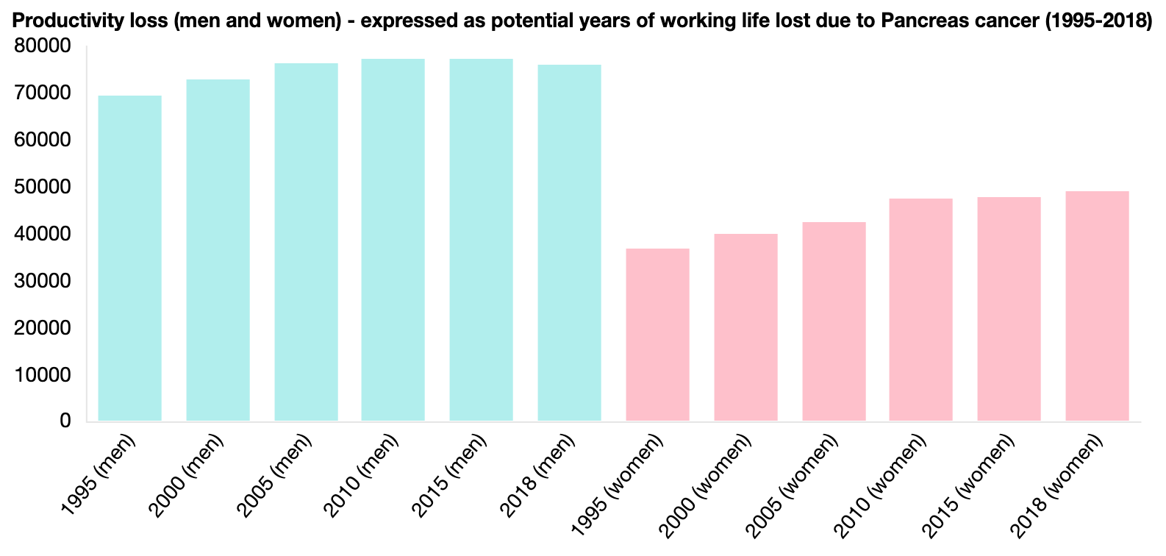
PANCREATIC CANCER SPENDING
Hofmarcher, T et al. (2019) Comparator Report on Cancer in Europe 2019 - Disease Burden, Costs and Access to Medicines. IHE Report 2019:7. IHE: Lund, Sweden. For further information, please follow: https://efpia.eu/cancer-comparator-report/

