Slide 1
Medicines Adaptive Pathways to Patients (MAPPs):
Saving Time, Saving Lives
Thursday, 4 June 2015, 11:00-12:30
Cercle Cité, Grand Auditorium, Luxembourg

Slide 2
Jeremy Haigh, EFPIA
Moderator
Introduction

Slide 3
Meeting Agenda
11:00 - 11:05 Introductions Jeremy Haigh, EFPIA, Moderator
11:05 - 11:20 Keynote Address: Hans-Georg Eichler, Senior Medical Officer, EMA
11:20 - 11:55 Progress Reports
  Karin Van Baelen, Head Global Regulatory Affairs at Janssen, J&J, 2014 – MAPPs Deliverables
  James Anderson, Head of Corporate Government Affairs, GSK - Lessons Learned: Development, Regulatory, and Access Policy
  Luk Maes, Executive Director Regulatory Europe, BMS - The CSA, Moving MAPPs through IMI2
11:55 - 12:30 Moderated Panel Discussion
  Hans-Georg Eichler, Senior Medical Officer, EMA
  Sue Forda, VP-Global Regulatory Affairs-International, Eli Lilly
  Sarah Garner, Associate Director Science Policy and Research, NICE
  Nathalie Seigneuret, Senior Scientific Project Manager, IMI

Slide 4
Medicines Adaptive Pathways to Patients (MAPPs)
Luxembourg, EFPIA Annual Meeting, June 2015
Hans-Georg Eichler
Senior Medical Officer

Slide 5
How it all started
Realisation of competing objectives
Allow timely access for patients to address urgent medical need
Enable precision medicine, ‘difficult’ indications
Ensure sustainability of the innovation engine
Allow only well-studied drugs on the market
Rely on robust study methodology and end points
Ensure sustainability of health care systems

Slide 6

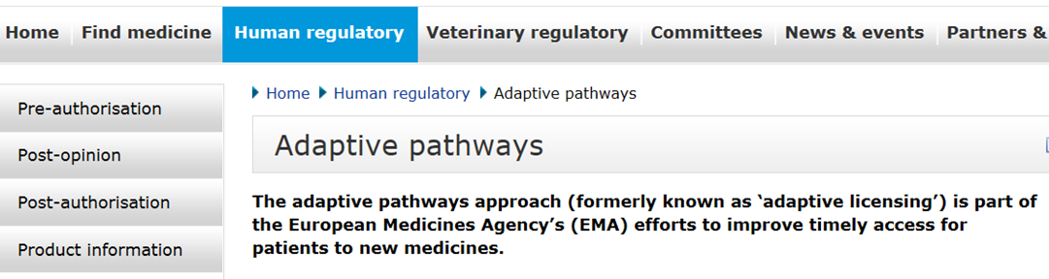
Evolution of thinking and terminology
Adaptive licensing, progressive approval, staggered approval →
Licensing is necessary but not sufficient →
Adaptive pathways, MAPPs
www.ema.europa.eu

Slide 7
What do we hope to achieve?
MAPPs seeks to foster access to beneficial treatments for the right patient groups at the earliest appropriate time in the product life-span in a sustainable fashion.
[from the mission statement for ADAPT SMART]

Slide 8
Who stands to benefit? 1/2
Patients and Providers
  Earlier access to promising new medicinal products
  Lower realised harm
Pharma
  Earlier revenue stream; staggered development costs
  Decrease risks of (costly) late stage failures and post-market withdrawals

Slide 9
Who stands to benefit? 2/2
Regulators
  Continuous reduction of uncertainty throughout the lifetime of the product
  New risk management paradigm that may restore public confidence
Payers
  Adaptive reimbursement plan to align value with price and utilisation
  Continuous risk/benefit information flow to better support (follow-on) coverage decisions

Slide 10
A systems approach – to realise the benefits
Comprises the entire product life-span:
Development → licensing → coverage → utilization → monitoring
Clinical
Development
Regulatory
Assessment
HTA / Payer
Assessment
Product on the market
Marketing
Authorisation
Coverage
Decision
Adaptive Pathways:
Adaptive Licensing & Managed Entry Agreements

Slide 11
What will change with adaptive pathways?
Transition from …
Magic moment → life-span management
Prediction → monitoring
RCT only → toolkit for evidence generation
Big populations → small populations
Focus on licensing → focus on patient access
Open utilisation → managed utilisation

Slide 12
EMA’s initiatives to enable timely access for patients
Operational: Procedural support for major public health needs (not discussed today)
Case learnings: Adaptive (Licensing →) Pathways pilots
Conceptual: IMI Medicines Adaptive Pathways to Patients (MAPPs)

Slide 13
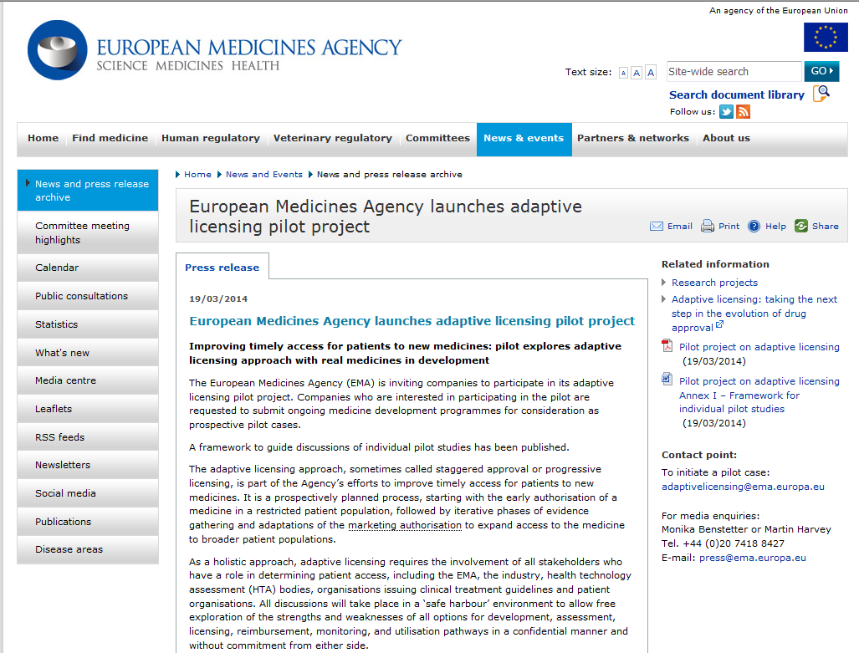
www.ema.europa.eu

Slide 14
Rules of the game
The discussion is non binding, safe-harbour brainstorming.
Involve all stakeholders to discuss how to optimise development path and satisfy stakeholder requirements.
Demonstration of positive Benefit/Risk is –as usual- required for approval – but more initial uncertainty acceptable.
Only existing regulatory tools to be used.
AP is flexible.
Acceptance/rejection in the AP pilot bears no inference about approval potential.

Slide 15
Initial experience
58 products submitted as candidates (7 still to be assessed)
16 selected for in-depth discussion with company (Stage I)
Of the selected products:
  5 are Orphan drugs
  2 are ATMPs (Advanced Therapy Medicinal Products)
  5 are Anticancer drugs
8 products selected for Stage II (in-depth meetings)
Have we achieved the hoped-for
level of creativity?

Slide 16
Levels of adaptive creativity? 1/2
Traditional:
Phase I Phase II Phase III MA
Adaptive:
MA (small population) RWD
Phase I/II
RCT MA (extended population)
MA Marketing Authorisation
RWD Real World Data
RCT Randomised Controlled Trial

Slide 17
Levels of adaptive creativity? 2/2
“Adaptive Creative”:
“Efficacy shown”
MA*
RWD
Success > 80%
Phase I/II
RCT
Success 30-80%
No-go
Success <30%
MA Marketing Authorisation
RWD Real World Data
RCT Randomised Controlled Trial
* Provided acceptable toxicity

Slide 18
The IMI MAPPs project
Coordination and Support Action on MAPPs
Expected deliverables (from the IMI call text):
Gap analysis – lessons from IMI (and non-IMI) projects
Informing research activities – facilitate inclusion of tools/ methodologies in IMI2 research projects
Knowledge management – horizon scanning of non-IMI activities

Slide 19
The ADAPT-SMART consortium
Three overarching themes (“work packages”):
Evidence generation throughout the life span
Designing the MAPPs pathway
Decision-making, sustainability and implications

Slide 20
Conclusions
The MAPPs concept seems to be the best option to address the competing objectives faced by the healthcare ecosystem.
Plenty of opportunities to be seized - but plenty of obstacles to overcome.
Many decision-makers aligned (for now).
The time is right to collaborate to pro-actively facilitate and accelerate the availability of MAPPs.

Slide 21
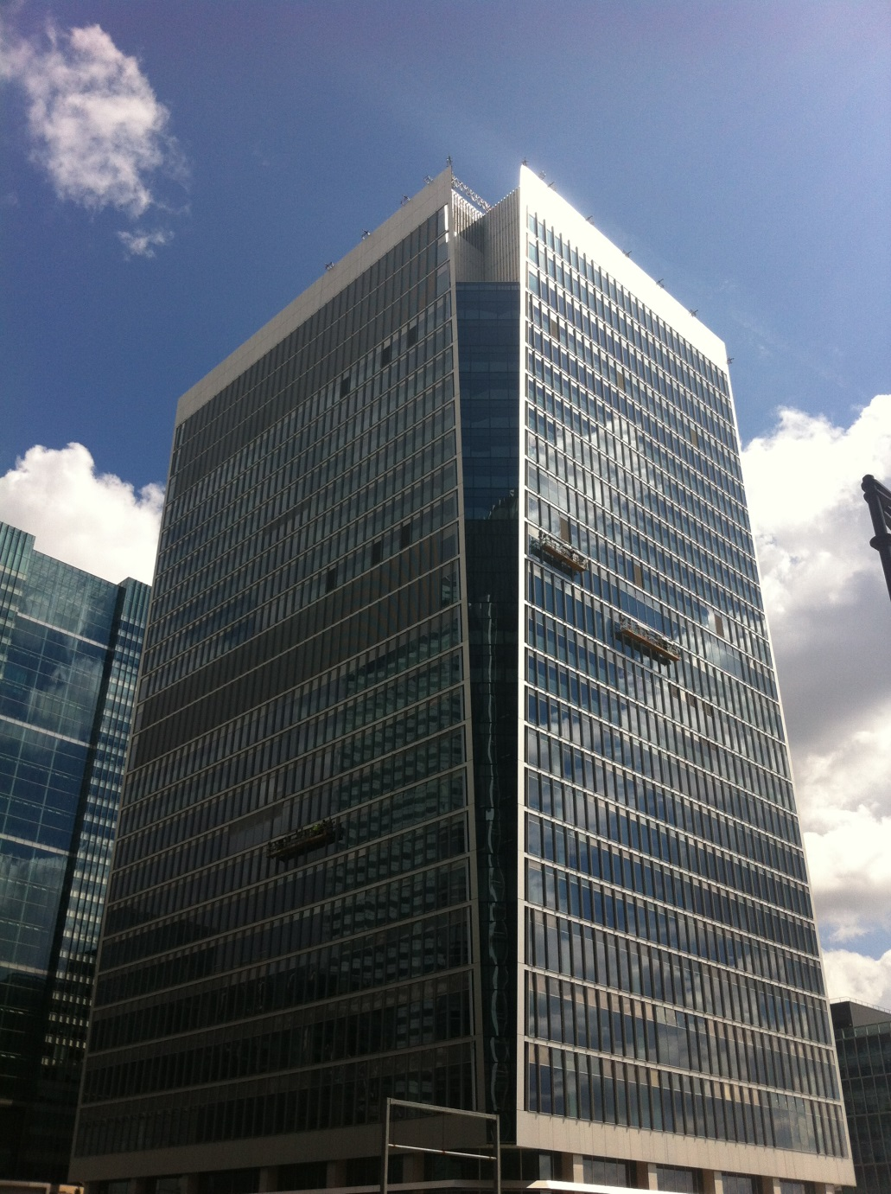
Thank you
European Medicines Agency
30 Churchill Place, London

Slide 22
MAPPs 2014-2015 Deliverables
Creating Awareness and Building Consensus
Karin Van Baelen
Head Global Regulatory Affairs at Janssen, J&J
Chair, MAPPs Taskforce
Notes:
June 2012 - EFPIA Board adopted the R&D and regulatory pathways strategy objectives:
Modernize development and regulatory models
Increase predictability and productivity of R&D
Accelerate patient access to safe, innovative treatments.
Seven themes:
Progressive marketing authorization – now MAPPs
Benefit/risk assessment and collection of real life data
New trial design and associated statistical methodologies
Adapt regulatory framework to new science and products
Global medicines development ensuring global coordinated regulatory framework
Regulatory excellence
Incentives

Slide 23
MAPPs: What does it mean?
Flexible development and access pathways within the current regulatory framework that balance early patient access, public health and societal benefits.
How is MAPPs different from Current Pathways?
An early authorisation of a product in a well-defined and targeted patient population with a clear safety and efficacy profile
The target population is adjusted as additional evidence becomes available
MAPPs may integrate adaptive clinical trial design, patient centric benefit/risk assessments and continuous re-evaluation as new evidence becomes available
MAPPs relate to the entire life cycle of a medicine from development, through licensing to patient access
Notes:
The goal of MAPPs is to balance timely access for patients with the need to provide evolving information a new therapy’s benefits and risks.
MAPPs are being piloted in Europe, and we believe MAPPs will eventually incorporate adaptive clinical trial design, patient centric benefit/risk assessment and continuous evaluation as new real-world evidence becomes available.

Slide 24
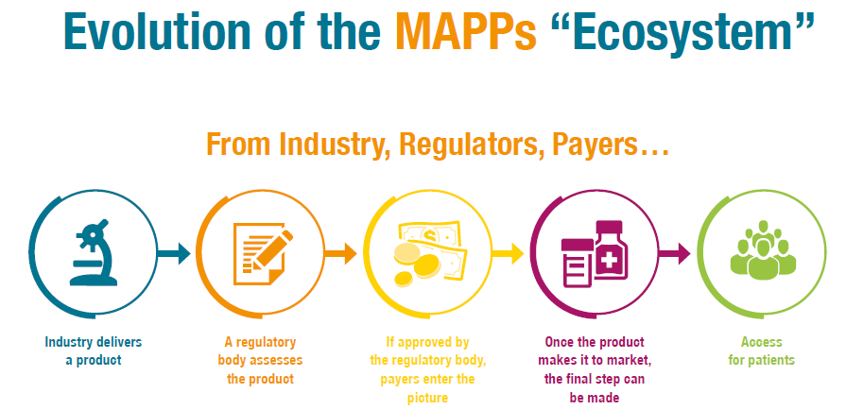
Notes:
The stakeholder relationships for MAPPs visualized. No longer is the regulatory process a series of bilateral discussions between a drug company and a regulator, payer, HTA, etc in a linear fashion…
The evidence required and ‘success metrics’ are agreed in advance, and the performance of the therapy is evaluated based on actual evidence generated by how the new therapy performs in patients.

Slide 25
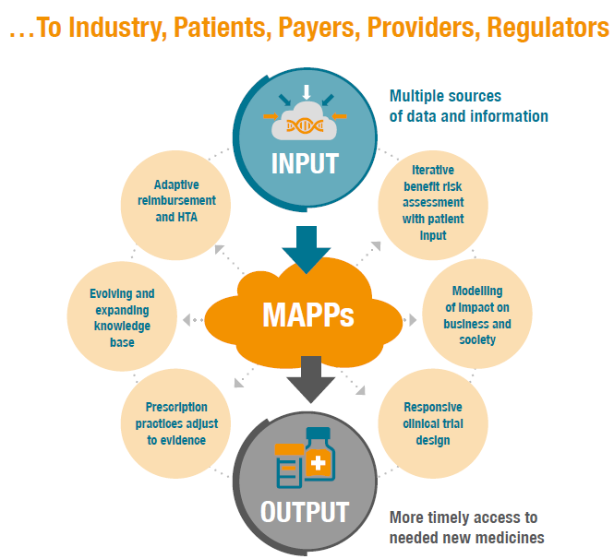
Notes:
MAPPs imply that ALL stakeholders in the decision making process are involved at the start of designing the MAPPs trial.
The evidence required and ‘success metrics’ are agreed in advance, and the performance of the therapy is evaluated based on actual evidence generated by how the new therapy performs in patients.

Slide 26
MAPPs Deliverables 2014-2015
Objectives | Explore the feasibility and the benefits of adaptive approaches in the context of current regulatory framework
Expected deliverables | Pilots submitted to EMA’s Safe Harbour and learnings shared IMI2 projects Aligned understanding with all stakeholders
Notes:
An extraordinary amount of activities , many are ongoing

Slide 27
MAPPs
and
EMA: Pilot
Commission: STAMP

Slide 28
EMA MAPPs Pilot
EMA has 58 applications as of April 2015, of which roughly one-third have been selected for further discussion
Tools are needed to stimulate designing a non linear adaptive pathway, as current pilots are essentially linear in design
Industry is trying to respond to the request for more ‘creative intelligence’ in pilot submissions
Next Steps:
  Use pilot to develop feedback and recommendations to improve processes for industry and EMA for MAPPs going forward
  Include feedback into CSA - Adapt Smart to improve process and create needed tools & methodologies.
Conference report, Royal College of Physicians, Oct 21st, 2014
Notes:
This slide gives an update as of May 5, 2015, as to the status of the EMA MAPPs pilot.

Slide 29
Commission Expert Group on Safe and Timely Access to Medicines for Patients (STAMP)
International Representatives from 23 Member States and the European Medicines Agency
Optimise the use of existing regulatory tools to improve the safe and timely access and availability of medicines for patients
Provide advice and expertise to the Commission services in relation to the implementation of the EU Pharmaceutical legislation,
HTA, pricing and reimbursement will not be the focus of the STAMP
BUT: “synergies will be created with other groups and
European activities on these issues…this holistic approach means that market access cannot be separated from pricing and reimbursement decisions and strategies

Slide 30
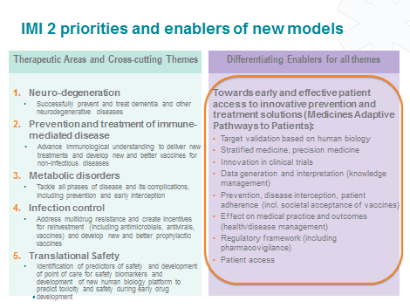
MAPPs
and
IMI

Slide 31
Developed guiding principles, identified new IMI topics and established CSA
Neurodegeration
Immune Mediated Diseases
Metabolic Disorders
Infections control
Translational safety
Evidence generation and exploitation
MAPPs
Guiding principles MAPPs: enablers/deliverables that address regulators/payers/
business questions – to be included in thematic programmes
MAPPs specific IMI2 projects
Coordination and Support Action (CSA)
Patient preference elicitation (B/R)

Slide 32
IMiPACT – IMI Platform for exploitation of results
Think tank/platform financed by IMI and coordinated by CASMI
Nine-month Analysis of IMI1 projects, results and tools to that can be used to facilitate faster implementation of MAPPs
  Translate new R&D tools and methodologies into regulatory and payers practice
  set success metrics
  identify implementation opportunities and barriers
Four projects were identified covering pre-clinical, clinical, and post-marketing stages
  SAFE-T, DIRECT, DDMoRe, EHR4CR
Multi stakeholder conference organised in October 2014 in London to disseminate results

Slide 33
MAPPs
and
External Stakeholder Engagement
Notes:
Drive international outreach, bringing together decision makers from patients, industry, payers, HTAs, practitioners and regulators to both create awareness and build consensus
Develop traction with thought leaders to create an environment supportive of MAPPs amongst key opinion leaders and decision makers
Enhance the discussion and debate around MAPPs, to remove bottlenecks to the mutli-stakeholder approach to the life cycle evaluation of new therapies.

Slide 34
MAPPs Flagship Outreach Projects
Oct 21, 2014 International Conference, Better Science Better Health, Sponsors: EFPIA, Newdigs, IMI, Vital Transformation
11 MAPPs themed sessions at DIA Euromeeting Paris April 2015, cross-cutting all thematic areas
Quarterly webinar/broadcast series featuring an average of 250 participants per webinar from a broad cross-section of stakeholders
Number of Peer Review Publications
MAPPs task force, IMI, Newdigs, and Vital Transformation have been invited to organise an international conference in partnership with the US Congress and Senate in Washington DC
  Focus is “An International Gathering of the World’s Thought Leaders in New Healthcare Models”

Slide 35
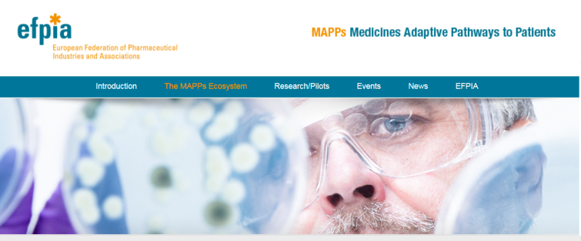
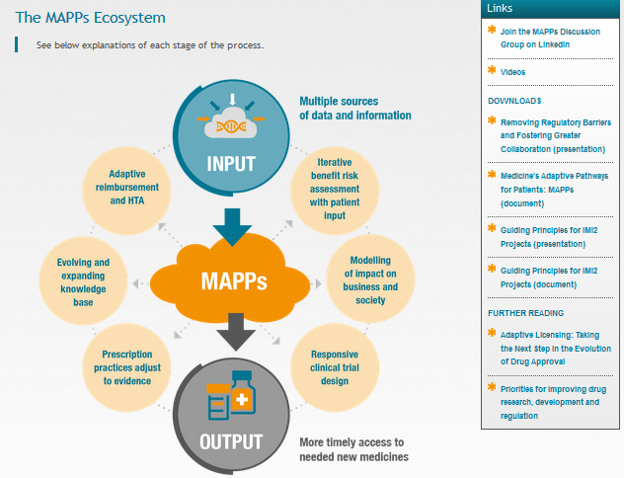
Dedicated MAPPs microsite http://efpiamapps.eu
Standard Presentation
English
Executive summary
One Pager
H.G Eichler et al. http://onlinelibrary.wiley.com/doi/10.1038/clpt.2011.345/full
S Forda et al.
http://onlinelibrary.wiley.com/journal/10.1002/%28ISSN%291532-6535

Slide 36
MAPPs 2014-2015 Deliverables
QUESTIONS?
Karin Van Baelen
Head Global Regulatory Affairs at Janssen, J&J
Chair, MAPPs Taskforce
Notes:
June 2012 - EFPIA Board adopted the R&D and regulatory pathways strategy objectives:
Modernize development and regulatory models
Increase predictability and productivity of R&D
Accelerate patient access to safe, innovative treatments.
Seven themes:
Progressive marketing authorization – now MAPPs
Benefit/risk assessment and collection of real life data
New trial design and associated statistical methodologies
Adapt regulatory framework to new science and products
Global medicines development ensuring global coordinated regulatory framework
Regulatory excellence
Incentives

Slide 37
Lessons Learned
Development, Regulatory, and Access Policy
James Anderson, Head of Corporate Government Affairs, GSK

Slide 38
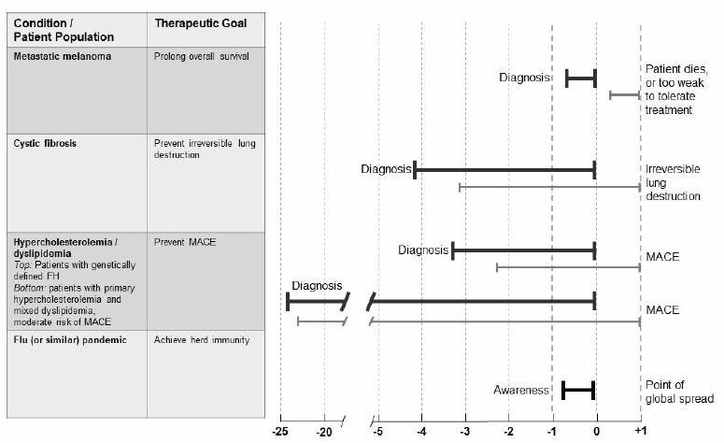
Why MAPPs is Important – “Treatment Window of Opportunity”
Ref: Eichler HG, et al. From adaptive licensing to adaptive pathways: delivering a flexible life span approach to bring new drugs to patients. Clin Pharmacol Ther. 2015 Mar;97(3):234-246

Slide 39
How Much Evidence is Enough?
And Who Needs to Agree?
R&D
Regulatory Approval
National Access/ HTA
Local Access
Physician
Patient
10,000
1,000
100
10
1
Number of Decision-Makers

Slide 40
We Need to Square the Value Circle
BIG ELEPHANT
Proposed Principle 1: Companies should expect at least the same financial reward for developing a medicine under an adaptive pathway, as under a traditional one
Proposed Principle 2: “Payers” should expect similar value for money for a medicine delivered under an adaptive pathway, as under a traditional one
Innovation Fund
Fixed payment (not volume-based)
Interim agreements – bridge the gap
Risk-sharing – prices up and down

Slide 41
4 Emerging Myths we Need to Address
Potential Myth 1: MAPPs only “works” in Rare Diseases
  Many aspects of Rare Disease R&D fit with MAPPs
  But other diseases and development challenges also fit well:
    Science enables risk or benefit based patient targeting
    Traditional development infeasible: too long/too many patients needed/can’t generate required evidence
    Traditional development not economically viable
Potential Myth 2: R&D investments will be lower under MAPPs than Traditional development pathways
  Investments before first approval lower, but higher post-launch – company may need to build monitoring infrastructure
  Costs of failure may increase due to accelerated investments (eg manufacturing, parallel work)
Potential Myth 3: Product prices will be lower under MAPPs than Traditional development pathways
  More targeted patient populations may gain greater health benefits (and therefore value) – even if not fully demonstrated at launch.
  Investments and risks may increase or decrease
  Value provided to patients who are within treatment window.
Potential Myth 4: Significant risks to companies in proposing assets into the EMA AP Pilot

Slide 42
Lessons Learned
QUESTIONS?
James Anderson, Head of Corporate Government Affairs, GSK

Slide 43
MAPPs: Coordination and Support Action (CSA)
An IMI2 Public Private Partnership
Luk Maes, Executive Director Regulatory Europe, BMS

Slide 44
Medicines Adaptive Pathways to Patients (MAPPs) CSA
Implementation of adaptive approaches in the EU requires aligned understanding of and agreement(s) on related issues, the participation of real enablers for the respective stakeholders, and the design of a pragmatic pathway to access.
As such, the overall scope of this CSA is to establish an enabling platform for the coordination of MAPPs related activities within IMI2 and engaging a dialogue (safe harbour) with relevant stakeholders.

Slide 45
MAPPs CSA
EFPIA proposal to create a “platform” with relevant stakeholders for MAPPS-related activities within IMI2 discussed/prepared during 2014
Formation of Public – Private Consortium ADAPT SMART
  EMA/national HAs, patient and HTA/payer representation + project management
  EFPIA companies (22)
Start July 1st, 2015 => 30 months

Slide 46
Consortium Participants
PRIVATE | EFPIA
ABBVIE | AbbVie
AMGEN | Amgen
ASTELLAS | Astellas
AZ | AstraZeneca
BSP | Bayer AG
BI | Boehringer Ingelheim
BMS | Bristol-Myers Squibb Int’l Corp.
GSK | GlaxoSmithKline
IPSEN | Ipsen
JPNV | Janssen Pharmaceutical Companies
ELI LILLY | Eli Lilly and Company
HLU | H. Lundbeck A/S
LYSO | LYSOGENE
MERCK | Merck KGaA
MSD | Merck Sharp & Dohme
NOV | Novartis International AG
NOVO | Novo Nordisk
PFIZER | Pfizer, Inc.
ROCHE | F. Hoffmann-La Roche AG
SARD | Sanofi S.A.
UCB | UCB
PUBLIC
EMA | European Medicines Agency
DHMA | Danish Health and Medicines Authority
EPF | European Patients’ Forum
TI PHARMA | Stichting Top Institute Pharma (Escher Platform)
UOXF | Masters and Scholars of the University of Oxford
EURORDIS | European Organisation for Rare Diseases
NICE | National Institute for Health and Care Excellence
HAS | Haute Autorité de Santé
ZIN | Zorginstituut Nederland

Slide 47
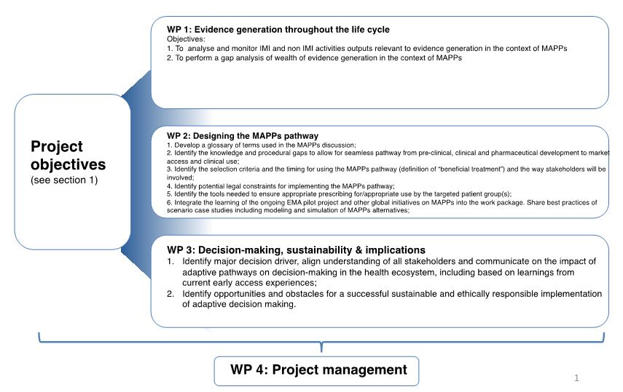
Enable “creative intelligence” - CSA Work Packages

Slide 48
ADAPT SMART - Structure

Slide 49
Stakeholders Network
Stakeholder network (within EU) via outreach program as part of communication plan
Stakeholders group expected to include (but not be limited to):
  Completed/ongoing IMI projects
  Academia, SMEs
  CPath, TRANSCELERATE, CDISC
  ASCO (TAPUR, Targeted Agent and Profiling Utilization Registry)
  KU Leuven (CIR, Center for IP Rights)
  21st Century Cures proponents, ……..
IMI remark during final review: “A number of important decision makers and stakeholders are not represented among consortium partners”
  Payer involvement, contribution of prescribers and medical societies and outreach to SMEs (the latter via EuropaBio and EBE) assured as their organisation(s) will be part of Stakeholders Network and invited to contribute to development/ comment on documents, attend workshops and other meetings as applicable, and be involved in scenario designs

Slide 50
MAPPs: Coordination and Support Action (CSA)
QUESTIONS?
Luk Maes, Executive Director Regulatory Europe, BMS

Slide 51
Panel Discussion
Hans-Georg Eichler, Senior Medical Officer, EMA
Sue Forda, VP-Global Regulatory Affairs-International
  Eli Lilly
Sarah Garner, Associate Director Science Policy and Research, NICE
Nathalie Seigneuret, Senior Scientific Project Manager, IMI
Jeremy Haigh, EFPIA, Moderator

