Slide 1
ONE HEALTH
DR. Theo Kanellos
Director, Strategic Alliances
Zoetis International Services

Slide 2

ZOETIS: AN ADVOCATE OF ONE HEALTH
27
8
4.8+
CORE
ANIMAL
SPECIES
$
MANUFACTURING
SITES
300+
BILLION
PRODUCT
LINES
SALES
R&D COLLEAGUES
1,100+
WE PROVIDE
MEDICINES
VACCINES
DIAGNOSTICS
GENETIC TESTS
SERVICES
5
60+
MAJOR PRODUCT CATEGORIES
YEARS
OF
EXPERIENCE
OUR FOCUS
MARKET PRESENCE IN
120+
APPROXIMATE COLLEAGUES AROUND THE WORLD
34%¹
10,000
65%¹
3,500+
COMPANION
ANIMAL HEALTH
LIVESTOCK
HEALTH
¹Excludes revenue associated with Client Supply Services, which represented 1% of total 2014 revenue.
MEMBER ZOETIS
FIELD FORCE
COUNTRIES

Slide 3
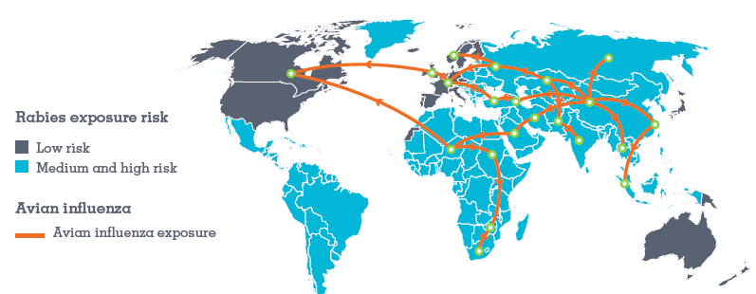

DISEASE KNOWS NO BOUNDARIES

Slide 4
WHY IS ONE HEALTH IMPORTANT?
COST OF CONTROL OUTBREAK
EXPOSURE IN ANIMALS
EXPOSURE IN HUMANS
CLINICAL SIGNS IN ANIMALS
CLINICAL SIGNS IN HUMANS
HUMANS SEEK MEDICAL CARE
Adapted from Institute Of Medicine (2009)

Slide 5
TIMEFRAME OF PRODUCT DEVELOPMENT
HUMAN HEALTH PROJECT LIFECYCLE*
3-6 Years
6-7 Years
0.5-2 Years
Discovery/Preclinical
Phase One
Approval Process
Phase Two
Phase Three
First in Human Decision
ANIMAL HEALTH PROJECT LIFECYCLE :
KEY DIFFERENTIATORS
Feasibility in target species understood early in project lifecycle
Shorter duration for field trials
Process scale-up and transfer to manufacturing generally drives development timeline
PhRMA, 2009

Slide 6
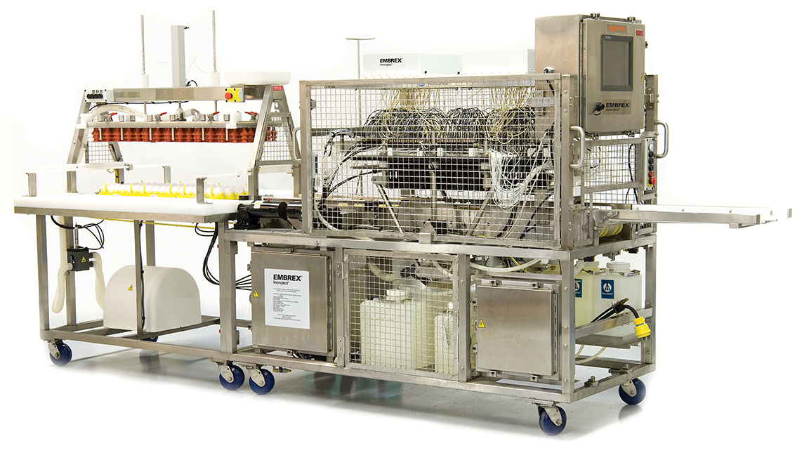
SUCCESS OF ONE HEALTH APPROACH
RAPID DEVELOPMENT OF H1N1 VACCINE FOR SWINE
1
First industry partner to receive USDA approval
for H1N1 vaccine
Developed vaccine in a record 4-month period
Scientific Development
Manufacturing Scale-up
Regulatory Approvals
A ONE TEAM approach with USDA
Prudent risk-taking & innovations
Strain selection, parallel efforts in scale-up and clinical studies
Manufacture of extensive supplies before market needs were
fully defined,
Bioreactor, lyophilization cycle
Zoetis’ INOVOJECT has been used in the manufacturing of human flu vaccines
2
3
4
5

Slide 7


SUCCESS OF ONE HEALTH APPROACH
JAK INHIBITORS: TOFACITINIB / OCLACITINIB
HUMANS
ANIMALS (DOGS)
Pfizer pioneered janus kinase inhibitors
In 2012, Xeljanz (tofacitinib) was approved in the US for rheumatoid arthritis, the first of a new class of kinase inhibitors that inhibit intracellular signaling pathways triggered by cytokines
In 2013, Zoetis, launched APOQUEL® (oclacitinib), a New Veterinary Class Targeting the Itch and Inflammation Pathway in dogs
Oclacitinib (JAK-1) came from the same program that yielded tofacitinib
~10% of dogs have atopic dermatitis that can impact the quality of life for the dog and its owner
JAK enzymes are involved in cell signalling pathways activated by various cytokines
APOQUEL® reduces itch, and provides long term relief of itching and inflammation for dogs

Slide 8
EFPIA’s “PARTNERS IN RESEARCH” COULD FOSTER “ONE HEALTH” INNOVATIONS
To Advance Impactful Solutions to Control Common Animal and Human Diseases by:
Co-supporting the rapid development of technologies to prevent and control emerging and re-emerging pathogens
Implementing holistic control strategies for zoonotic diseases mainly in developing countries
To Enhance Innovative Research on Diseases with Common Pathophysiology by:
Implementing novel One Health translational research models
Developing the necessary capacities for ‘One Health’ research
Launching targeted One Health research calls
To Spark New Business Models to Augment Commercialization of Innovation by:
Utilising Animal Health as a fast platform for new biotechnology products and diagnostics
Establishing clinical development and regulatory synergies between R&D pipelines
Interspersing expertise, research tools and resources to enhance R&D pipelines

Slide 9

A strategic forum for the continuation
of the One Health debate

Slide 10

Thank you

