Slide 1








From innovation to outcomes; medicines costs in context
Author: Andrew Powrie-Smith * Date: 05/04/2016 * Version: DRAFT
Pricing
^{www.efpia.eu}

Slide 2
About this deck
The Medicines Costs in Context slide deck has been developed to support members in communicating and engaging stakeholders on issues around price and value of medicines in an evidence based way. The deck can be used in conjunction with the EFPIA narrative on price.
The deck seeks to put the price of medicines and spending on medicines in the context of their impact on patients, on healthcare systems and on society. It does this through the following sections:
  The value of medicines to patients, healthcare systems, economies and society
  Putting spending on medicines in Europe In context; separating fact from fiction
  Examining the challenges in delivering innovative treatments
  Working with governments and healthcare systems in Europe to find solutions to Europe’s healthcare challenges.
  The deck is designed as a communications tool to support engagement on price, value and affordability. The main deck contains evidence to support the narrative. Additional technical evidence is available through the Health & Growth evidence compendium.

Slide 3
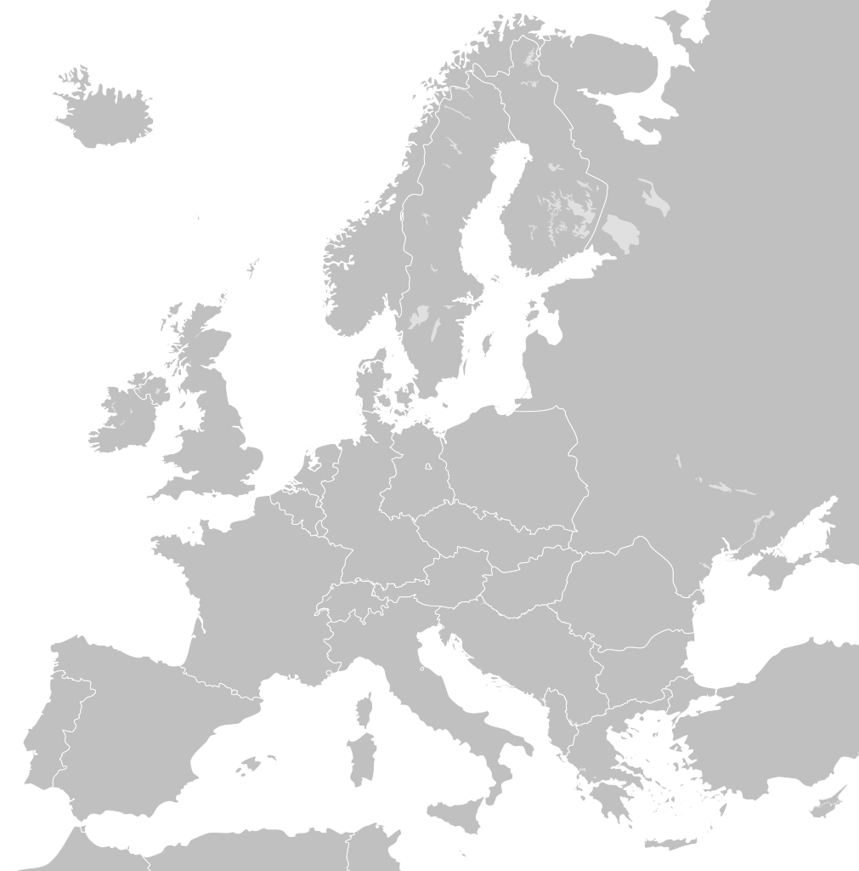
SECTION 1: The value of medicines to patients, healthcare systems and society
PATIENTS
ECONOMIES
    Patients live longer, healthier, more productive lives
The biopharmaceutical industry generates essential economic value in terms of job creation, R&D investment, and medications that improve patient productivity
HEALTHCARE SYSTEMS
SOCIETY
HEALTHCARE SYSTEMS
Innovative medicines can put healthcare systems on a more sustainable path by reducing costs in other parts of the healthcare system such as hospitlisations
Society benefits from health and wellness as individuals are able to continue being productive members of the community

Slide 4
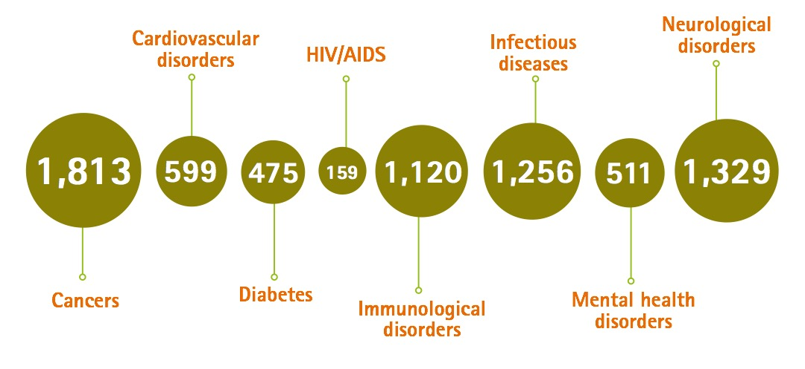
With over 7000 medicines in development, the exciting new wave of medical innovation will play a key role in
addressing the challenges faced by patients and healthcare systems
Source: Health Advances analysis; Adis R&D Insight Database. March 2015, compiled by PhRMA

Slide 5
Value to patients
Patients all over the Europe are living longer, healthier and more productive lives thanks to innovative medicines developed by biopharmaceutical companies.

Slide 6
For many patients and their families
Medicines have significantly increased chances of survival
Cancer
New therapies have contributed to significant declines in cancer death rates around the world since its peak in 1991. Today, 2 out of 3 people diagnosed with cancer survive at least 5 years¹.
Percent Decline in Cancer Mortality Rates Since 1991
1991 to 2011 - All Cancers²
-21%
-22%
-15%
-8%
EU5
Canada
Japan
South Korea
-24%
-17%
-21%
Mexico
USA
Australia
Source: Health Advances analysis; ¹PhRMA 2016 Prescription Medicines: Costs in Context; ²WHO Mortality Database (accessed February 2016).

Slide 7
For cancer patients, Life expectancy continues to improve the use of innovative medicines has made major contribution to recent advances
From 2000 – 2009, an improvement in population weighted mean life expectancy at birth of 1.74 years was seen across 30 OECD countries.
Innovative medicines are estimated to have contributed to 73% of this improvement once other factors are taken into account (e.g. income, education, immunization, reduction in risk factors, health system access).
Source: Lichtenberg, F: Pharmaceutical innovation and longevity growth in 30 developing OECD and high-income countries, 2000 - 2009 (2012)

Slide 8
Medicines are some of the most powerful tools in
treating and curing deadly diseases
Hepatitis C Virus (HCV)
HCV, which is the leading cause of liver transplants and the reason liver cancer is on the rise, is now curable in more than 90% of treated patients with only 8-12 weeks of treatment.
+133% cure rate increase for patients in Europe²
15 million
people are living with Hepatitis C in Europe¹
8-12 Weeks*
12 Weeks*
24-48 Weeks*
48 Weeks*
95-96%
cure rate
90%
cure rate
63-80%
cure rate
41%
cure rate
1st generation (1999-2010) Interferon and Ribavarin (IFN-R) Injection | 2nd generation (2011-2013) Protease Inhibitors w/ IFN Injection | 3rd generation (2013-2014) Polymerase Inhibitors w/ IFN Injection | 4th generation (2014-2015) Oral Combination Therapies
* Treatment duration.
Note: EMA approval dates. Cure rates are based on the results of clinical trials reported by the US Food and Drug Administration (FDA) for different drugs against Hepatitis C.
Source: Health Advances analysis; ¹Hope 2014 Prevalence and estimation of hepatitis B and C infections in the WHO European region Epidemiol Infect; European Medicines Agency (EMA) website; ²EFPIA 2015 Health & Growth Evidence Compendia analysis of PhRMA 2014 25 Years of Progress Against Hepatitis C and PhRMA 2015 Pharma Profile.

Slide 9
Medcines are transforming outcomes for
patients living with chronic disease
 | Cardiovascular Disease In Europe, biopharmaceutical companies are currently developing 172 medicines* to treat heart disease, stroke and other cardiovascular diseases.¹ New PCSK9 inhibitors have revolutionized therapy for high cholesterol. Between 2000 and 2012, the death rate from cardiovascular disease fell 37% in the EU5, 27% in Japan, and 5% in Mexico.²
 | Diabetes Between 2000 and 2012, new therapies contributed to a 48% and 31% decline in the diabetes death rate in Korea and Canada, respectively.²
 | Rheumatoid Arthritis The recent introduction of disease-modifying therapies has dramatically improved the lives of patients and caregivers by slowing and sometimes even reversing negative physical symptoms of the disease.³
Death rates for
non-communicable diseases declined nearly 20%
in the EU5, Australia, Canada, and Japan from 2000 to 2012²
* Medicines in Phase I through III of development.
Note: The 4 main types of non-communicable diseases, also known as chronic diseases, defined by WHO are cardiovascular diseases (e.g. heart attacks and stroke), cancers, chronic respiratory diseases (e.g. chronic obstructed pulmonary disease and asthma) and diabetes.
Source: Health Advances analysis; ¹PharmaProjects (accessed February 2016); ²WHO Mortality Database (accessed February 2016); ³PhRMA 2015 Pharma Profile.

Slide 10


Effective therapeutics and vaccinations have contributed to the
Fight against communicable diseases
Italy was the first industrialized country to introduce a program for routine vaccination against hepatitis B virus (HBV); this program led to an 82% decline in the incidence of HBV from 1991 to 2010.²
In England, infant deaths declined 79% from 2012 to 2013 as a result of a maternal pertussis vaccination program.¹
.
Source: Health Advances analysis; ¹Amirthalingam 2014 Effectiveness of maternal pertussis vaccination in England The Lancet. Boccalini 2013 Economic analysis of the first 20 years of universal hepatitis B vaccination program in Italy Human Vaccines & Immunotherapies,

Slide 11
Effective therapeutics have transformed HIV/AIDS from a
Death sentence to a manageable disease
HIV/AIDS
HIV/AIDS Age-Standardized Death Rates (ASDR)
By Country
Country | Decline in ASDR (1995-2013*)
 | -88%
 | -92%
 | -87%
 | -94%
 | -87%
 | -88%
 | -82%
 | -73%
HAART combinations introduced
* Or latest year of available data: Italy (2012), France (2011), Canada (2011), Australia (2011), Germany (2011).
Note: HIV/AIDS ASDR extrapolated for Italy in 2004-2005 and Australia in 2005.
Source: Health Advances analysis; WHO Mortality Database (accessed February 2016).

Slide 12
Biopharmaceutical companies around the world have driven
a decade of advances in medicines
2006:
First vaccine for the prevention of cervical cancer
First Rx for chronic chest pain in 20 years
First once-a-day HIV medicine
2012:
First drug to target root cause of cystic fibrosis
First drug to treat Cushing’s disease
2014:
Oral treatments for HepC provide cure rates upwards of 90%
17 new drugs to treat patients with rare diseases
7,000 medicines in development around the world
2004:
First anti-angiogenic medicine for cancer
New Rx for most common form of lung cancer
2008:
A new type of treatment for Crohn’s disease
The first Rx for symptoms of Huntington’s disease
2010:
2 new multiple sclerosis drugs
First therapeutic cancer vaccine
2004
2005
2006
2007
2008
2009
2010
2011
2012
2013
2014
2005:
First new kidney cancer Rx in over a decade
3 new therapies for diabetes
2009:
First treatment for peripheral T-cell lymphoma
First new Rx for gout in 40 years
2013:
2 new personalized medicines to treat the most dangerous forms of skin cancer
A new oral treatment for multiple sclerosis
2007:
New class of medicines to treat high blood pressure
First treatment for fibromyalgia
2011:
First lupus drug in 50 years
2 new personalized medicines
Note: Dates of innovation provided by the US Food and Drug Administration (FDA).
Source: Health Advances analysis; PhRMA 2015 Biopharmaceuticals in Perspective.

Slide 13
An Improved Understanding of Disease and Personalized Medicines Have Resulted in
increased patient survival
Advances in personalized medicine have improved the outlook for patients with blood cancers in Europe¹
Improved Understanding of the Disease
60 YEARS AGO
50 YEARS AGO
40 YEARS AGO
TODAY
“Disease of the Blood”
Leukemia
Lymphoma
Chronic Leukemia
Acute Leukemia
Pre-leukemia
Indolent Lymphoma
Aggressive Lymphoma
~40 unique Leukemia types identified
~50 unique Lymphoma types identified
Today, 230 medicines* ²
are in development for blood cancers in Europe
A greater understanding of the molecular basis of disease has transformed what was once known collectively as “disease of the blood,” into multiple subtypes of leukemia and lymphomas, which can be targeted by personalized medicines
Chronic Lymphocytic Leukemia 5 year survival rates have grown to 70%³
Hodgkin’s Lymphoma
5 year survival rates have grown to 80%³
* Medicines in phases I through III for the treatment of all types of leukemia and lymphoma.
Source: Health Advances analysis; ¹PhRMA 2015 Value of Personalized Medicine; ²PharmaProjects (accessed February 2016); ³Cancer Survival in Europe Eurocare 5 Database 2000-2007.

Slide 14
Disease Diagnosis enables a targeted approach to personalised medicines that has Resulted in
decreased death rates from cancer
The evolution of molecular characterization and targeted therapeutics has led to a decrease in the average lung cancer death rate in the United Kingdom by 37% since 1980
Age-standardized death rates per 100,000 world standard population over time¹
45.1 deaths per 100,000
32.6 deaths per 100,000
30.5 deaths per 100,000
28.4 deaths per 100,000
1980
2000
2007
2012
Adenocarcinoma
0 identified
1 identified
5 identified
12 identified
Identified Mutations/Rearrangements over Time^{2,3}
Note: WHO Mortality Database age-standardized death rates per 100,000 for malignant neoplasm of trachea, bronchus and lung.
Source: Health Advances analysis; ¹WHO Mortality Database (accessed February 2016); ²My Cancer Genome website – Molecular Profiling of Lung Cancer; ³Pao 2012 Chipping away at the lung cancer genome Nat Med.

Slide 15
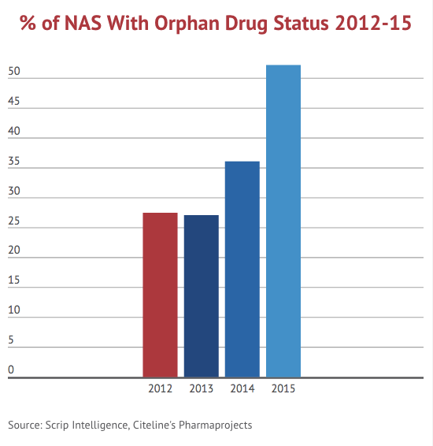
Biopharmaceutical Companies Have Made
continued advances against rare diseases
Percentage of New Active Substances launched with orphan drug status 2012-2015
There are approximately 7,000 different rare diseases worldwide
1 in 10 individuals in the USA and Europe are living with a rare disease¹
Rare Disease
Big Impact
Source: Health Advances analysis; ¹PhRMA 2013 Rare Diseases Report
Source: Alexis Schimmings, New active substances launch plummet , Scrip Intelligence Unit. Available at : http://www.scripintelligence.com/home/New-Active-Substance-Launches-Plummet-363577

Slide 16
Today more than 7000 medicines
Are in Development Around the World Targeting Areas of High Unmet Need
Medicines in Development Worldwide
Biopharmaceutical companies are focusing on areas of high unmet need
Biopharmaceutical companies have made significant gains in key disease areas
HIV/AIDS is now a manageable, chronic disease, thanks to prior advances in biopharmaceutical research
Note: Defined as single products which are counted exactly once regardless of the number of indications pursued.
Source: Health Advances analysis; Adis R&D Insight Database.

Slide 17
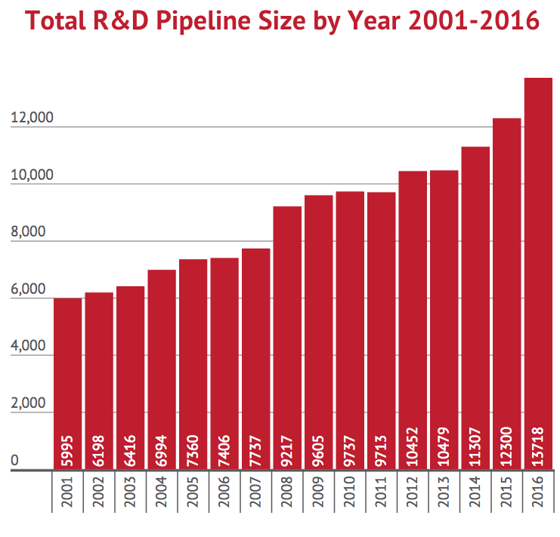
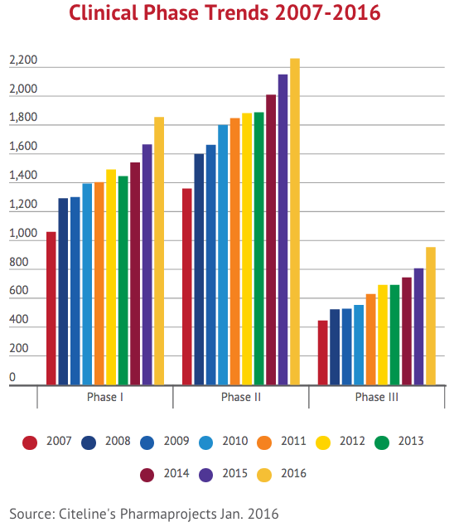
Pharmaceutical R&D pipeline is growing significantly : there are more medicines in development today than ever before
Script’s article. Pharma’s Unstoppable R and D Machine: Pipeline Gets Bigger than Ever, 25 February 2016

Slide 18
Medicines often demonstrate
Far greater benefits than understood at time of approval
Oncology therapeutics demonstrate increasing clinical value over time long after initial approval
Use in earlier lines of treatment and earlier in stages of the disease
Use in additional disease indications
Use in combination with other agents
Use in combination with specific biomarkers
Year 11: Approved for Use Earlier in Line of Treatment
MCL – First Line
Year 6: Approved for Use Earlier in Line of Treatment
MM – First Line
Year 4: Additional Indication
Mantle Cell Lymphoma (MCL) – Second Line
Year 3: Approved for Use Earlier in Line of Treatment
MM – Second Line
Year 1: Initial Approval
Multiple Myeloma (MM) –
Third Line
Additional Patients Benefiting
Added Clinical Value Over Time
Note: Representation of the change in clinical value over time in the US as additional data and evidence became available for Bortezomib.
Source: Health Advances analysis; Boston Healthcare Assoc. 2015 The Value of Innovation in Oncology.

Slide 19
Medicines often demonstrate
Far greater benefits than understood at time of approval
Many cancer medicines provide years of extra life but media attention is often focused on soon after launch and/or in late stage patients before it has had the chance to prove long-term value
Metastatic use
Adjuvant use
Oncology medicines typically launched only in metastatic setting. i.e. very sick patients that have failed on other therapies with poor prognosis
Measured ‘outcomes’ for such patients by definition will be relatively poorer
Once an oncology medicine is more established it can be used in an adjuvant setting (i.e. patients with a better prognosis – before tumours have spread)
Measured outcomes, by definition for such patients often better than patients whose cancer is more advanced
Early assessment can show relatively poor value for money but such ‘static assessments do not reflect value over the lifecycle
Often prices that were seen as high when initially assessed are seen as highly cost effective by the time a medicine is in adjuvant use. Important to consider value over the lifecycle

Slide 20
Value to healthcare systems
Innovative medicines can put healthcare systems on a more sustainable path by reducing costs in other parts of the healthcare system such as hospitalisations and clinicians time
.

Slide 21
Medicine use yields
Significant health gains and savings in other parts of the healthcare systems
New Cardiovascular Medicines Led to Direct Savings on Hospitalizations in 20 OECD Countries*, 1995-2004
1.6-2.1 million
The number of influenza cases averted with the current use of seasonal influenza vaccination in Europe.¹
€250-330 million
Per capita expenditure on cardiovascular hospitalizations would have been $89 (70%) higher in 2004 had new cardiovascular medicines not been introduced in the period 1995–2004.²
Total influenza-related costs saved annually from averted GP visits, hospitalizations, and lost days of work as a result of the current use of seasonal influenza vaccination in Europe.¹
* Countries included: EU5, Australia, Austria, Belgium, Canada, Czech Republic, Finland, Hungary, Japan, Korea, New Zealand, Norway, Poland, Slovak Republic, Spain, Switzerland, Turkey, USA.
Source: Health Advances analysis; ¹Preaud 2014 Annual public health and economic benefits of seasonal influenza vaccination; ²Lichtenberg 2009 Have newer CV drugs reduced hospitalization in 20 OECD countries Health Econ.

Slide 22
The cost of disease could bankrupt healthcare systems
Without new medicines
In the UK, a treatment delaying the onset of dementia by 5 years would result in^{* 2}:
€22 billion
savings in Germany by 2040 from the development of new medicine that halts the progression of Parkinson’s Disease (PD)³
savings if medicine slows progression by 20%²
666,000 fewer people with dementia
566,000 fewer informal carers required
£21.2 billion (36%) reduction in the cost of dementia
€3.9 billion
* Study duration and savings modeled through 2050 for an intervention that would delay the onset of dementia by 5 years and would become available in 2020.Source: Health Advances analysis; ¹PhRMA 2016 Prescription Medicines: Costs in Context; ²Alzheimer’s Research UK 2014 Defeat dementia policy report; ³Johnson 2012 Economic value of slowing Parkinson’s Disease in Germany: Modeling progression through Hoehn and Yahr Stages ISPOR 15th Annual European Congress.

Slide 23
CANCER:
The costs of cancer medicines represent a small share of overall cancer treatment costs and a fraction of the total healthcare costs
Spending on cancer medicines across the EU represents only
1% of Overall Healthcare Spending…
Total Healthcare Spending
Cancer Drugs
Cancer Drugs
Cancer Medicines as a Portion of Total EU Healthcare Spending, 2009
…and only 1/4 of Total Spending on Cancer Care¹
Other
Care*
Cost of Cancer Treatment in the European Union, 2009
* Other Care includes costs for Primary Care, Outpatient Care, Accident and Emergency costs, and Inpatient Care.
Source: Health Advances analysis; Reuters and University of Oxford publications; ¹Luengo-Fernandez 2013 Economic burden of cancer across the European Union Lanc Onc.

Slide 24
The development of new medicines is shifting
The paradigm of treatment towards cure and prevention
Preventative medicines developed for cardiovascular disease and diabetes are helping patients avoid serious complications of their disease
Cardiovascular disease (CVD) causes more than half of all deaths across the European Region.¹
52 million Europeans are living with diabetes today.³ Up to 80% of people with diabetes will die of CVD.²
  Combination drug therapy for CVD (such as aspirin, beta blockers, diuretics and statins) prevents serious complications, and has led to a 75% reduction in myocardial infarction among high risk individuals¹ ²
Pharmacological intervention can prevent individuals with impaired glucose tolerance from developing diabetes*¹
Diabetic retinopathy is an important cause of vision loss in Europe, however, through screening and treatment, blindness can be prevented in individuals at high risk¹
* Pharmacological interventions reduced the risk of developing diabetes by 31% in individuals with impaired glucose tolerance.
Source: Health Advances analysis; ¹WHO 2006 Gaining Health: The European Strategy for the Prevention and Control of Noncommunicable Diseases; ²WHO 2005 Preventing Chronic Diseases: A Vital Investment; ³WHO 2010 Delivering for diabetes in Europe; WHO European Guidelines on Cardiovascular Disease Prevention in Clinical Practice, WHO Diabetes Data and Statistics Webpage.

Slide 25
Value to the Economy
The biopharmaceutical industry generates essential economic value in terms of job creation, R&D investment, and medications that improve patient productivity

Slide 26
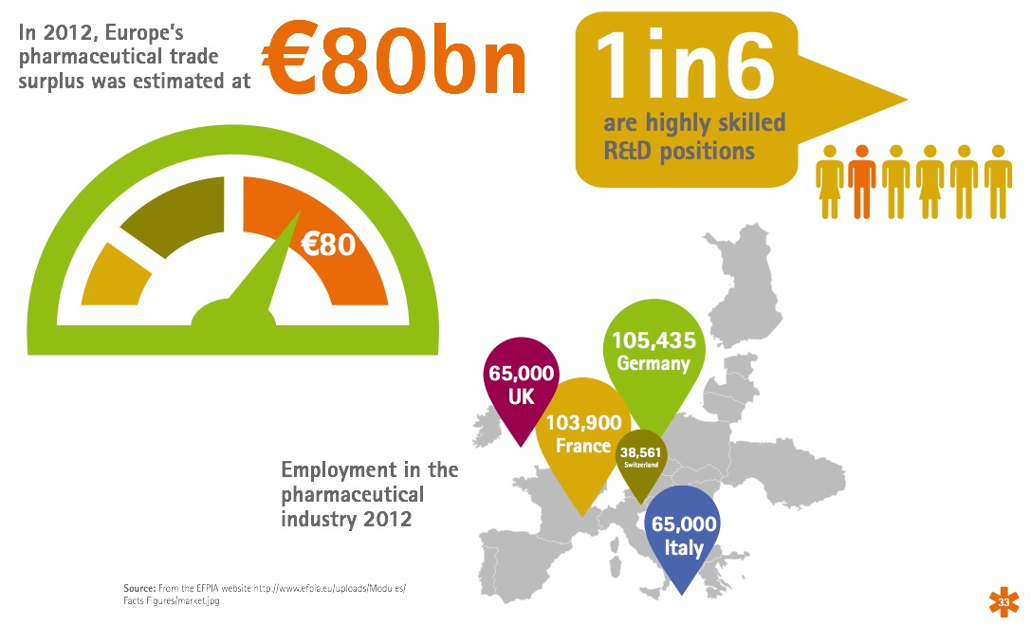
The biopharmaceutical industry makes a significant contribution to the European economy

Slide 27
The Biopharmaceutical Sector is the
Second largest funder of R&D in Europe
Share of European Business R&D by Industry, 2014*
The biopharmaceutical sector accounts for the second largest share of all business R&D, representing 19% of all domestic R&D funded by EU businesses.
Automobiles & Parts | Pharmaceuticals & Biotechnology | Technology Hardware | Aerospace & Defense | Electronic & Electrical Equipment | Industrial Engineering | Software & Computer Services
* The remaining 26% share of business R&D spending is conducted by other industries including chemical sector, the general industrial sector, and the professional, scientific, and technical services sector, among others.
Source:: Health Advances analysis; European Commission 2015 EU Industrial R&D Investment Scoreboard.

Slide 28
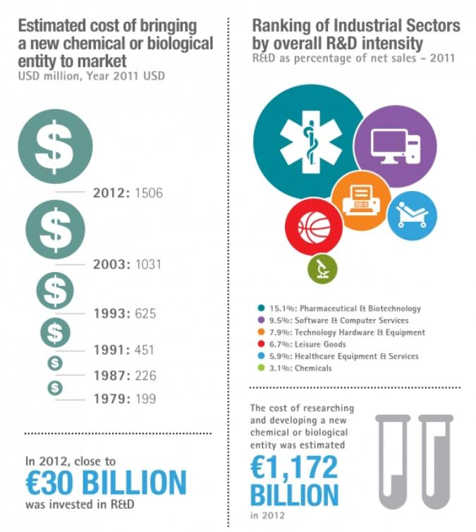
The pharmaceutical industry invests more of its revenue in generating new knowledge through research and development than other sectors
R&D spending as a percentage of net sales, 2014
14.4%: Pharmaceuticals and biotechnology
10.4%: Software and computer services
8%: Technology hardware and equipment
7.3%: Leisure goods
4.2%: Healthcare equipment and services
2.6%: Chemicals
* Industrial sectors ranked by R&D intensity (R&D as a percentage of net sales) Note: data relate to the top 2,500 companies with registered offices in the EU (633), Japan (387), the USA (804) and the Rest of the World (676), ranked by total worldwide R&D investment (with R&D investment above €15.5M)Source: The 2014 EU industrial R&D investment scoreboard, European Commission, JRC, DG RTD.

Slide 29
The biopharmaceutical sector adds the
most value to the economy per employee
Gross Value Added per Employee, 2012, 000’s Euros
Pharmaceutical employees in Europe are generating
80% more value
per employee than other industries,
Note: Europe is defined here as the EU-28 plus Norway; Gross value added for each industry is defined as the gross income from operating activities per employee.
Source: Health Advances analysis; Eurostat Database (accessed February 2016).

Slide 30
Biopharmaceutical companies have invested a substantial amount
in R&D Across the Globe to Bring Innovative Therapies to Market
Over $1,100 billion invested in R&D since 2006
Another $900 billion expected investment from 2015-2020
Worldwide Pharmaceutical R&D Investment, in billions¹
“The most important challenge facing the global research community is ensuring that populations regard its contributions as positive, responsible and legitimate. R&D policy is not just about throwing money at scientists and engineers – it is also about ensuring that their innovations can be brought into use, which is a quite different challenge.” –
Domestic Corporation, UK (December 2013)²
Source: Health Advances analysis; ¹EvaluatePharma 2015 World Preview; ²Battelle 2014 Global R&D Funding Forecast.

Slide 31
Biopharmaceutical Companies Are The
Largest funder of R&D for chronic and deadly diseases
Pharmaceutical R&D Investment in the United Kingdom, 2012, by Disease Area
£490 million
£850 million
£160 million
£1,300 million
Source: Health Advances analysis; Sussex 2016 Quantifying the economic impact of government and charity funding of medical research on private research and development funding in the UK BMC Medicine.

Slide 32
Novel Therapeutics Address Healthcare Challenges
While also support economic growth
Novel, innovative treatments allow patients to work longer and more productively²
Ability to remain in employment
31 weeks longer
and earn €26,000 more than patient on conventional therapy
RA Patient
Novel Biologic
When comparing worker productivity for European, Australian, and Canadian patients with rheumatoid arthritis (RA), researchers found that patients were able to work longer and earn more money when treated with a novel biologic rather than conventional therapy* over the study period of 2 years.
Conventional therapy in study refers to conventional DMARDs = disease-modifiying anti-rheumatic drugs.
Note: Presenteeism is the act of attending work while sick.
Source:, ²Halpern 2009 Impact of Adalimumab on work participation in RA Ann Rheum Dis.

Slide 33
Industry-Sponsored clinical trials contribute
tangible economic activity to the communities in which they are located
Number of Industry-Sponsored Clinical Trials in Selected Countries, 2015
In 2015, the biopharmaceutical industry sponsored 9,059 clinical trials of medicines around the world, supporting tangible economic activity in the countries in which they are located.
Number of Clinical Trials
500+
400-499
300-399
200-299
100-199
0-99
Note: Represents all clinical trials Phase 0 through Phase 4 that registered with Clinicaltrials.gov in 2015.
Source: Health Advances analysis; Clinicaltrials.gov (accessed February 2016).

Slide 34
Value to society
Innovation can deliver significant societal value as development is strongly targeted at societal disease priorities and patients are able to continue contributing to the community.

Slide 35
Industry Development and Subsequent Approvals Have Historically Been
Targeting major unmet medical need
There is a strong association between industry development and priority disease areas with the largest impact on society
Size of Ball Indicates Share of Mortality per 100 000 in EU-25
Optimal Value for Society
Source: Health Advances analysis; Catala-Lopez 2010 Does the development of new medicinal products in the European Union address global and regional health concerns? Pop Health Met.

Slide 36
Innovative New Therapies Have Enabled Patients to
Continue contributing to society
Cancer
The overall rate of returning to work following a cancer diagnosis has grown to over 75% due to innovative therapies²
In France, 82.1% of working women diagnosed with breast cancer returned to work after a median sick leave of 10.8 months⁴
In the Netherlands, 83% of working individuals diagnosed with head and neck cancer returned to work, and most often within 6 months after treatment⁵
In Japan, 81% of patients diagnosed with cancer returned to work within 12 months of their initial sick leave³
  Note: In all three studies, return to work includes full-time and part-time work.
Source: Health Advances analysis; ²Amir Z 2009 Cancer Survivorship and employment Occup Med; ³Endo 2015 Returning to work after sick leave due to cancer: a 365-day cohort study of Japanese cancer survivors J Cancer Surv; ⁴Fantoni 2010 Factors related to return to work by women with breast cancer in Northern France J Occup Rehab; ⁵Verdonck-de Leeuw 2010 Employment and return to work in head and neck cancer survivors Oral Oncol.

Slide 37
Section 2:
  Putting the spending on medicines in Europe in context; separating fact from fiction

Slide 38
Healthcare systems face significant challenges in
Expanding access to healthcare while managing constrained budgets
LACK OF DATA FOR INFOMRED DECISION-MAKING
INCREASING SOCIAL/POLITICAL PRESSURES
AGING POPULATION
PERSISTANCE OF RISK FACTORS
GROWING CHRONIC DISEASE BURDEN
CONSTRAINED BUDGETS

Slide 39
An aging population and increasing prevalence of chronic disease
Are burdening healthcare systems
Ageing populations worldwide are leading to more chronic disease and greater demand for care
Population Over 80 Years Old¹
Population with Disease²
Source: Health Advances analysis; ¹OECD Health Statistics Database (accessed February 2016), ²CDD Health Interactive Data from NHIS , UK (accessed February 2016).

Slide 40
The vast majority of healthcare costs are due to the
prevalence of chronic disease
The growing chronic disease burden already represents a significant portion of healthcare expenditures in Europe
~75% of Europe’s healthcare bill is spent on chronic diseases, amounting to €700B annually³
Source: ³The EFPIA 2015 Health & Growth Evidence Compendia analysis of The Economist Intelligence Unit (2012).

Slide 41
Spending on pharmaceuticals is
A small percentage of total healthcare spending today
Spending on pharmaceuticals is a
small share
of total healthcare spending
in many countries around the world
* Total healthcare spend includes hospital care, physician/clinical services, home health and nursing home care, government admin and net cost of private health insurance, dental, home health, and other professional services as well as durable medical equipment costs.
Source: OECD health statistics compiled by EFPIA for the health and growth evidence compendium 2015

Slide 42
Spending on medication is
A small percentage of total disease spending
In Germany, medication spending is a small share of the total cost of many chronic diseases
COPD
CHF
Pharmaceutical Spend as a Percent of
Total Disease Spending, 2011
Diabetes
Alzheimer’s
Source: Health Advances analysis; EFPIA 2015 Health & Growth Evidence Compendia analysis of A.T. Kearney analysis 2012, Schwarzkop et al. 2010, and Damm et al. (2012).

Slide 43
Despite high cancer drug costs, spending on medicines is still a
Small percentage of total cancer spending
Cancer-Related Healthcare Costs, Millions
European Union, 2009
Total for European Union | France | Spain | Italy | United Kingdom | Germany
Source: Health Advances analysis; Luengo-Fernandez 2013 Economic burden of cancer across the European Union Lanc Onc.

Slide 44
Putting spending on medicines in perspective
Key Developed Markets*
USA
Japan
Germany
France
Canada
Spain
Total Spending on Hospital Care, 2012 | $2,650B | $458B | $377B | $265B | $150B | $138B
Total Spending on Pharmaceuticals, 2012 | $315B | $96B | $53B | $40B | $35B | $25B
Ratio (Hospital Care / Pharmaceutical Spend) | 5.7 | 2.9 | 3.6 | 3.2 | 2.8 | 3.4
Expenditures on hospital care across countries is three to six times the total spending on prescription medicines
}
3-6X
THE TOTAL
SPENDING ON
MEDICINES
VS
MEDICINE SPENDING
HOSPITAL CARE SPENDING
* Top 6 countries in terms of Total Healthcare Spend in the OECD, excluding the United Kingdom and Italy due to lack of data.
Note: Hospital Care defined as in-patient and out-patient care (home care and ancillary services not included). Pharmaceutical spending includes prescription and over-the-counter medicines.
Source: Health Advances analysis; OECD Health Statistics Database (accessed February 2016).

Slide 45
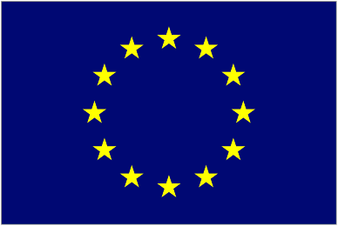









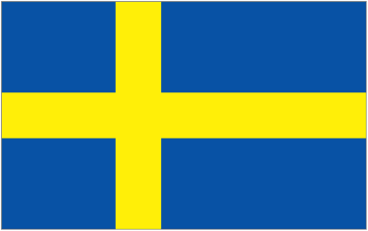
Innovation and Affordability is Promoted Through the Prescription Drug Life Cycle as
Pharmaceutical drug cost decline over time
Combination of generic price erosion and price regulation resulted in a 24% decline in medicine prices versus a 30% rise in consumer prices in Europe from 2000 through 2013.
Consumer Price Index (CPI) vs. Medicines Price Index, Population weighted, Year 2000 = Index 100
Population-Weighted, Europe
130
Price Index,
Year 2000 = Index 100
CPI
Medicines Price Index
76
Source: Health Advances analysis; EFPIA 2015 Sustainable Healthcare Systems Compendia analysis of various OECD databases (accessed in April 2015), Austria: pharmig based IFP; Belgium: Pharma.be; Finland: Pharma Industry Finland based on Statistic Finland; France: Leem based on INSEE; Germany: vfla based on GKV; Greece: SFEE based on Eurostat; Italy: farmindustria based on ISTAT; Spain: Farindustria based on INE; Sweden: LIF Sweden based on Apotekens Service, Netherlands: Farmingform based on the Central bureau of Statistics.

Slide 46
Cost-Reductions Over Time in Medical Procedures are
Dwarfed by generic cost reductions once a medicine goes off patent
Two Approaches to Cardiovascular Disease Management in the United Kingdom
Medical Procedure
Percutaneous Coronary Intervention (PCI)¹
Pharmaceutical Intervention
Atorvastatin 10mg²
-18%
Modest Cost Decline
$
Significant Cost Decline
-91%
Note: Cost of PCI: HRG Code EA31Z - Percutaneous Coronary Intervention, 0 to 2 Stents for a combined day case / ordinary elective spell tariff.
Source: Health Advances analysis; ¹Department of Health NHS National Tariff Reports 2012/13-2015/16; ²British National Formulary September 2012 and September 2015-March 2016.

Slide 47
The prescription drug life cycle enables
Low cost generic medicines to enter the market
Initial investment in innovation by Biopharmaceutical companies...
Significant investment required to research and develop a new product
Limited period of market exclusivity to recoup investment
Drug Approved
Preclinical
Development
Clinical Development
Innovator Drug Market Exclusivity
…paves the way for low cost generics to enter the market
Initial Patent Application Filed
20 Years Patent Protection
Patent Term Extension*²
Prescription Drug Price
Bioequivalency Testing
Generic Market
Generics Approved
Lower cost generics able to enter the market quickly following equivalency studies
0
2
4
6
8
10
12
14
16
18
20
22
24
26
28
30
32
34
36
38
40+
Example Prescription Drug Life Cycle (Years)¹
Possible to get additional exclusivity through the Hatch-Waxman Act which allows innovator companies to recoup up to half of time spent on clinical development and NDA filing to extend the effective patent life by up to 5 years. The total market exclusivity period cannot exceed 14 years.
Source: Health Advances analysis; ¹Shetty U 2013 Patents & Market Exclusivity Drugregulations.org; ²Bitlaw 35 U.S.C. 156: Extension Of Patent Term November 2015.

Slide 48
Promoting safe and effective bio-similars can lead to
Biologic medicine affordability
Biosimilar entry led to an average decrease in the cost of therapy from 17% in the HGH market to 39% in the G-CSF market throughout the EU
2013 Cost of Therapy Compared to 2006
Note: Countries included: Austria, Belgium, Bulgaria, Croatia, Czech Republic, Denmark, Finland, France, Germany, Hungary, Ireland, Italy, Norway, Poland, Romania, Slovakia, Slovenia, Spain, Sweden, Switzerland, UK. HGH = Human Growth Hormone (somatropin), EPO = Erythropoietin, G-CSF = Granulocyte Colony-Stimulating Factor.
Source: Health Advances analysis; IMS Institute for Healthcare Informatics 2014 Assessing biosimilar uptake and competition in European markets.

Slide 49
Healthcare systems can utilise savings through the use of generic medicines
Generics Share of the Total Pharmaceutical Market, 2014
Potential for cost savings through generic utilization
Source: Health Advances analysis; IMS MIDAS audited data.

Slide 50
Initiatives focusing on health outcomes instead of only cost containment can Both
Improve quality of care and reduce costs
Total Cost of Healthcare per Patient (Euros)
A recent study in Sweden targeting disease management found that patients enrolled in a heart failure program involving regular follow-up* with specialized nurses led to
improved outcomes and 30% reduced costs
through fewer hospital admissions and GP visits
* Regular follow up included frequent phone and in-person follow-ups with nurses and physicians to optimize patient’s heart failure treatment according to current guidelines, as well as receipt of information about heart failure from a validated computer-based awareness program.
Source: Health Advances analysis, Agvall 2014 Resource use and cost implications of implementing a heart failure program for patients with systolic heart failure in Swedish primary health care International J Cardiology.

Slide 51
Section 3:
  The challenges in delivering innovative medicines to patients

Slide 52
Despite Great Progress,
Challenges loom threatening continued innovation and patient access to medicines
INNOVATION IS HARDER
AND MORE COSTLY
INVESTMENT IN INNOVATION INCREASINGLY RISKY
Longer, more complex clinical trials
Government payers encouraging off label use of therapies to save money
Higher regulatory hurdles
Flourishing parallel trade
BIOPHARMA INNOVATION
Increased cost of R&D
Fiscal austerity measures
Unknown IP environment
CHALLENGES EXIST IMPEDING PATIENT ACCESS
Complex HTA processes delaying patient access
Clinical guidelines and restrictive cost-effectiveness requirements limiting access to best care
Contracting and tendering limiting therapeutic options

Slide 53
The biopharmacetical
research and development process
From drug discovery to EMA approval, developing a new medicine on average takes at least 10 years
Basic Research | Drug Discovery | Pre- Clinical |  |  | Clinical Trials |  |  | EMA Review |  | Post-Approval Research and Monitoring
 |  |  |  | Phase 1 | Phase II | Phase III |  |  |  | Phase IV
 |  |  | IND Submitted |  |  |  | INDA/BLA Submitted |  | EMA Approval
 |  |  |  | TENS | HUNDREDS | THOUSANDS
Post-Approval Research and Monitoring
1 EMA-
APPROVED
MEDICINE
POTENTIAL NEW MEDICINES
Number of Patients
Benefiting from Trials
Note: *The average R&D cost required to bring a new, FDA approved medicine to patients is estimated to be $2.6 billion over the past decade (in 2013 dollars), including the cost of the many potential medicines that do not make it through to FDA approval.
Key: IND: lnvestigational New Drug Application, NOA: New Drug Application. BLA: Biologics License Application.
Source: PhRMA 2016 Prescription Medicines: Costs in Context.

Slide 54



Medicines from lengthy national reimbursement review processes are mitigated in part by
industry sponsored access programmes
Average Time to National Patient Access to Necessary Therapeutics
Months Post Drug Approval
Drug Approval
 | 3 | 6 | 9 | 12 | 15 | 18
Limited Patient Access to Innovative Medicines
  In France, over 12,000 patients received novel medications in 2014 through pharmaceutical company sponsored early access programs in collaboration with the French ATU* program¹
In the UK, early access of a new therapeutic for patients suffering from melanoma was approved four months before market authorization was recommended by NICE²
Industry Getting Patients Medication Despite Review Process-Induced Delays
* ATU= Temporary Authorization for Use.
Note: Timelines for EU5 countries are based on products with first sales in 2014. Timelines for Spain, Italy, UK, and France represent time to pricing and reimbursement approval. In Italy and Spain, additional time may be required for regional or local negotiations. Timeline for Japan may range from 2-3 months, and represents a conservative estimate based on publicly-available descriptions of the pricing and reimbursement approval process. Switzerland’s separate regulatory approval may take at least 4-5 additional months after submission by manufacturer over timeline above. Norway is also not in EU and will need to formalize the EU approval, which may take at least 1 additional month.
Source: Health Advances analysis; ¹ANSM 2014 Annual Report; ²MHRA March 2015 EAMS Scientific Opinion for pembrolizumab.

Slide 55
Section 4:
  Pharmaceutical companies in Europe are working with governments and healthcare systems in Europe to find solutions to Europe’s healthcare challenges

Slide 56
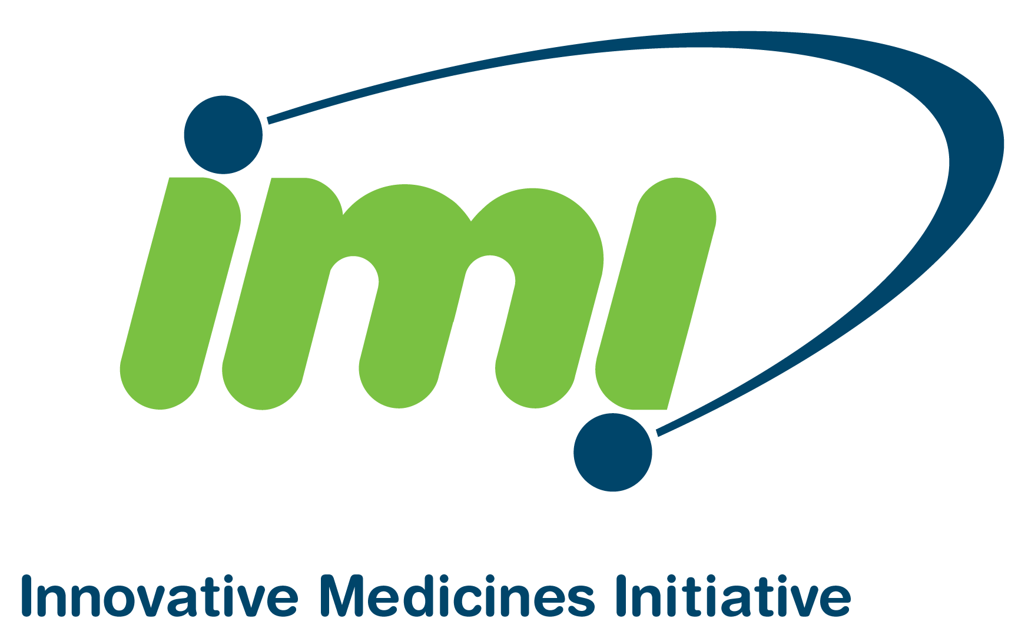

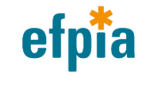
The Challenges Facing Healthcare Systems and the Scientific Community
Cannot Be Addressed By One Stakeholder Group Alone But
Through successful collaboration
IMI 2 Partnership and Funding Overview²
€1,638
€1,638
€3,276
The Innovative Medicines Initiative (IMI) is the world's largest public-private partnership
IMI supports collaborative research projects and builds networks of industrial and academic experts in order to boost pharmaceutical innovation in Europe.
Through the IMI 2, a joint undertaking between the European Union and the pharmaceutical industry association EFPIA, a
€3.3 billion budget for the period 2014-2024 has been established.
BILLION
BILLION
BILLION
2014-2024
PUBLIC
PRIVATE IN KIND
CONTRIBUTION
PUBLIC
PARTNERS
PRIVATE
PARTNERS
Biopharmaceutical Innovation
€1,638
€1,425
€3,276
From Horizon 2020
EFPIA direct and indirect member companies
€213
Other sectors
CASH for grants for PUBLIC PARTNERS
PRIVATE PARTICIPATION
Cash
People
Labs
Consumables
Source: Health Advances analysis; ¹IMI website; ²EFPIA 2014 Annual Report.

Slide 57
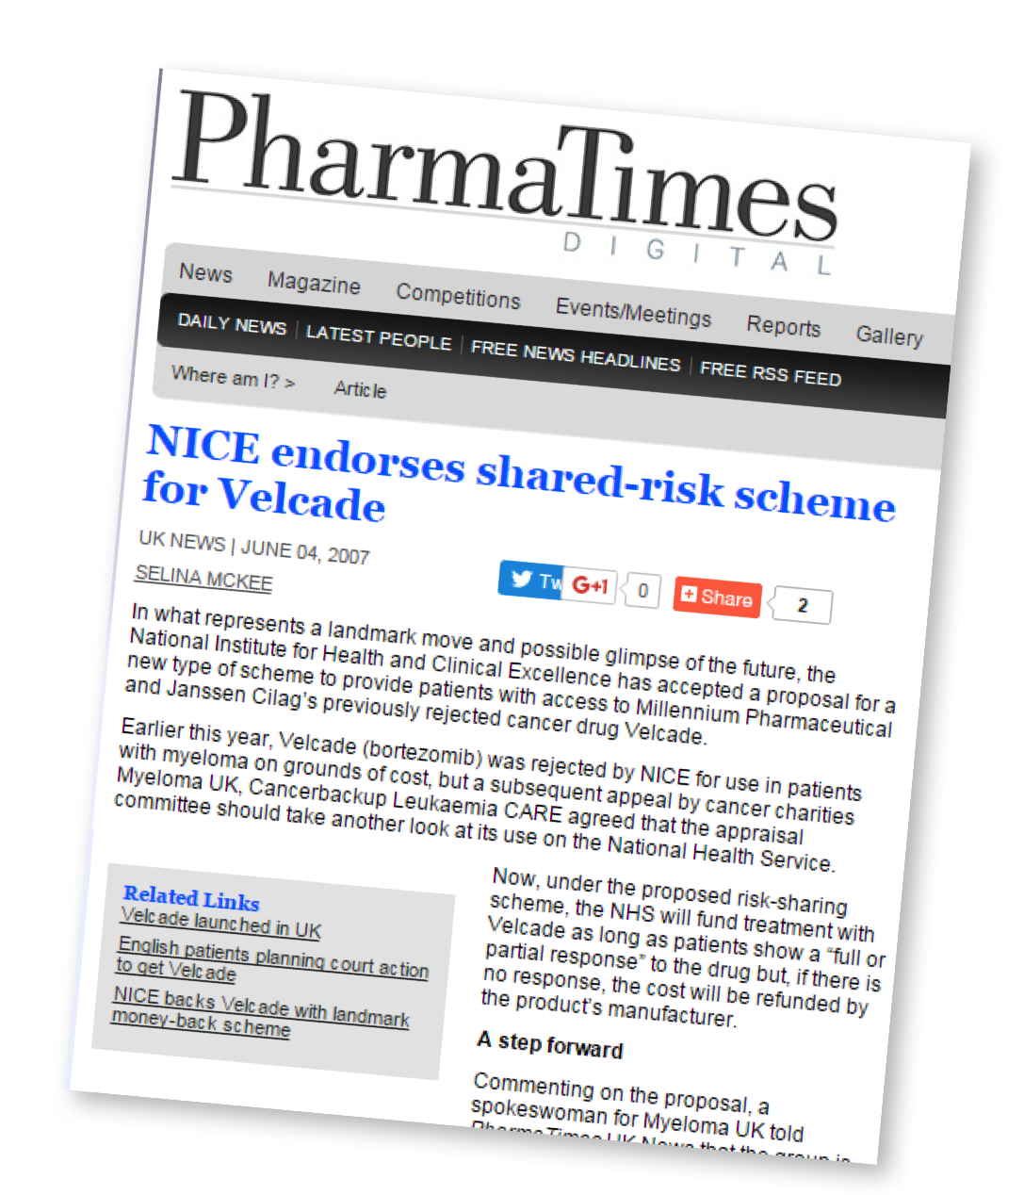
To support the shared objective of rapid access to the latest effective and life-saving medicines, industry remains committed to engaging with payers on flexible and innovative pricing and funding models
Outcomes-based reimbursement
Patient access schemes
Managed entry agreements for new medicines
A pioneering patient access scheme between industry and health services for the multiple myeloma treatment bortezomib in the UK saw reimbursement for patients who did not respond after four treatment cycles covered directly by the manufacturer with an average potential saving of GBP 12,198 per non-responsive patient1

Slide 58

Industry is keen to engage in the debate and to partner with payers to deliver outcomes driven sustainable healthcare systems
The objective of outcomes-focused healthcare systems is to deliver better patient outcomes at the same or lower cost...
relying on quality outcome data
as starting point to improve care cycle
Holistic approach
Transparent, high-quality
outcomes data
Medicines
Analyze
variation
Health
information
Care
management
Feedback
and
learning
Patient
Identify
current best
practices
MedTech
Care delivery
Change
behavior
Outcome
=
Value
Value
Cost
Benefits of a focus on outcomes: improved patient outcomes, reduced variation, reduced medical cost, continuous improvement

Slide 59
Across Europe, governments and the biopharaceutical industry are developing stability agreements that balance access to medicines with support for innovation
Voluntary agreement / Memorandum of understanding
Voluntary agreement under negotiation
Mandatory clawback
Latvia
LoI signed June 2015
Lithuania
Stability Agreement signed July 2014
Bulgaria
Minister of Health signed a broad Memorandum of Understanding in December 2015

Slide 60
Medicines are Part of the Solution…
and more can be done together
Governments, Providers, and National Payers
IMPROVE EFFICIENCY
PAY FOR VALUE
FIND SOLUTIONS
Look at all healthcare costs, reduce administrative costs and waste, and improve efficiency.
Support evidence-based care and empowered patients and providers, backed by sound research and strong quality measures.
Avoid blanket policies that chill investment, and collaborate to find new approaches.
CONTINUE DEVELOPING INNOVATIVE THERAPIES, PROMOTE MEDICATION ADHERANCE, MAINTAIN EFFORTS TO SUPPORT BROAD PATIENT ACCESS
Biopharmaceutical Companies

Slide 61
^{EFPIA Brussels Office}
Leopold Plaza Building * Rue du Trône 108
^{B-1050 Brussels * Belgium}
^{Tel: + 32 (0)2 626 25 55}
^{www.efpia.eu * info@efpia.eu}

